Slide 1
Notes:
Thank you for inviting me to speak at
Thank you to your active members who serve on Divisions, Committees, Subcomittees and elected bodies.
It is my honor to speak to you today about IUPAC…

Slide 2
IUPAC Presentation
23 August 2016

Slide 3
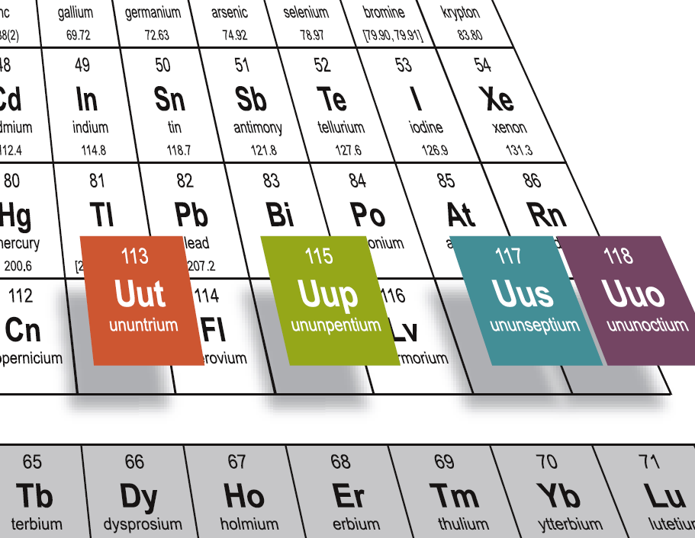
The Discovery Confirmed and Four New Elements Added (30 December 2015)
Names Announced 8 June 2016
Notes:
It has been a very exciting time lately, beginning with the announcement of the new Four Elements and completion of the seventh period.
Many relate the Periodic Table of the Elements with IUPAC, but I am here today to talk further about IUPAC.

Slide 4
Beyond the Periodic Table of the Elements
Who we are
What we do
How we do it
Why we do it
Where is our future direction
Opportunities for Engagement

Slide 5
Who We Are

Slide 6
IUPAC is an indispensable resource for chemistry.
Notes:
In 2015, a Strategic Plan task group was formed and has led to an updated Strategic Plan for IUPAC. The mission, vision, Core Values and our Unique role in the World Chemistry community was developed.

Slide 7
The International Union of Pure and Applied Chemistry is the global organization that provides objective scientific expertise and develops the essential tools for the application and communication of chemical knowledge for the benefit of humankind and the world.

Slide 8
The International Union of Pure and Applied Chemistry accomplishes its mission by
Fostering sustainable development
Providing a common language for chemistry
Advocating the free exchange of scientific information

Slide 9
CORE VALUES
We serve humankind by advancing chemistry worldwide.
Scientific excellence and objectivity are the cornerstones of all of our work.
We value collaboration and communication among all our stakeholders.
We strive for diversity and inclusiveness.
We respect each other and the Union
We uphold the highest standards of transparency, responsibility and ethical behavior.
Notes:
The core values provide the foundation of the strategy. They are principles that guide the conduct of the Union and its relationships with its stakeholders. IUPAC’s core values emphasize scientific excellence, communication, transparency, diversity, and ethical behavior. These behaviors are expected to be practiced by all of the Union’s volunteers, staff and stakeholders.

Slide 10
IUPAC’s unique role in the world chemistry community
• A focus on those aspects of chemistry where global consensus is essential for progress in research, commerce and policy.
• Respect for its objectivity and scientific excellence, providing access to the highest levels in the scientific, industrial, and policy communities to represent global chemistry.
• A worldwide base of volunteers with the best skills and background, recruited by transparent and well-understood processes.
Notes:
The task group articulated IUPAC’s unique role in the world chemistry community as follows:
A focus on those aspects of chemistry where global consensus is essential for progress in research, commerce and policy.
Respect for its objectivity and scientific excellence, providing access to the highest levels in the scientific, industrial, and policy communities to represent global chemistry
A worldwide base of volunteers with the best skills and background, recruited by transparent and well-understood processes.
IUPAC’s unique role in the worldwide chemistry community summarizes its value to its Members and stakeholders. IUPAC, with its global reach, can effectively convene the chemistry community through its Members and volunteers to address global needs through the contributions from the chemical sciences.

Slide 11
How we do it

Slide 12
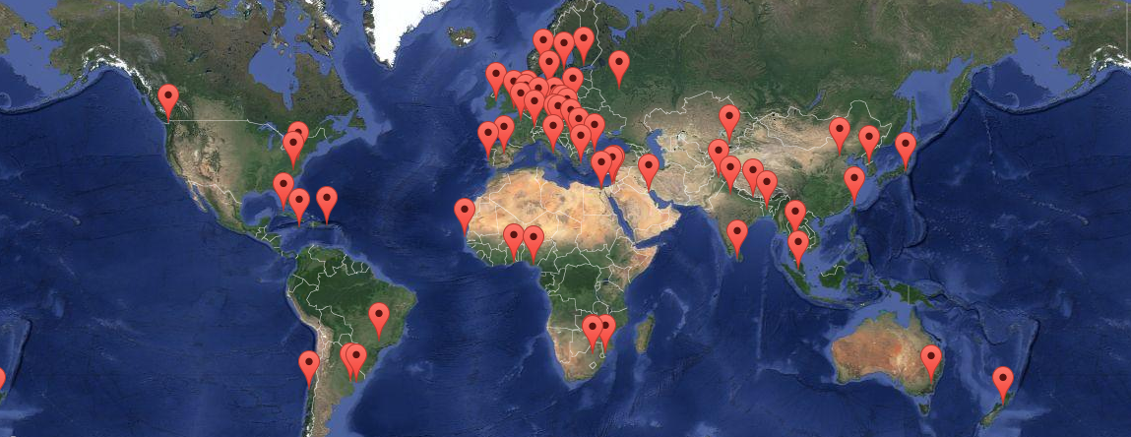
2016-2017 IUPAC Member Nations (57)
Governance of the Union

Slide 13

IUPAC Membership Programs
National Adhering Organizations-Are the Governing bodies (Council) of IUPAC
Associate National Adhering Organizations
  Observer Status-Chemical councils, Chemical Societies, National Academies and institutions representing national chemical interests
Associated Organizations
  International organizations that share common goals and interest with IUPAC.
Company Associates
  Industrial companies, research and development institutions can associate through the program
Individual Members
  Membership for individuals, coordinated by NAOs, Societies or directly with IUPAC

Slide 14
What we do

Slide 15
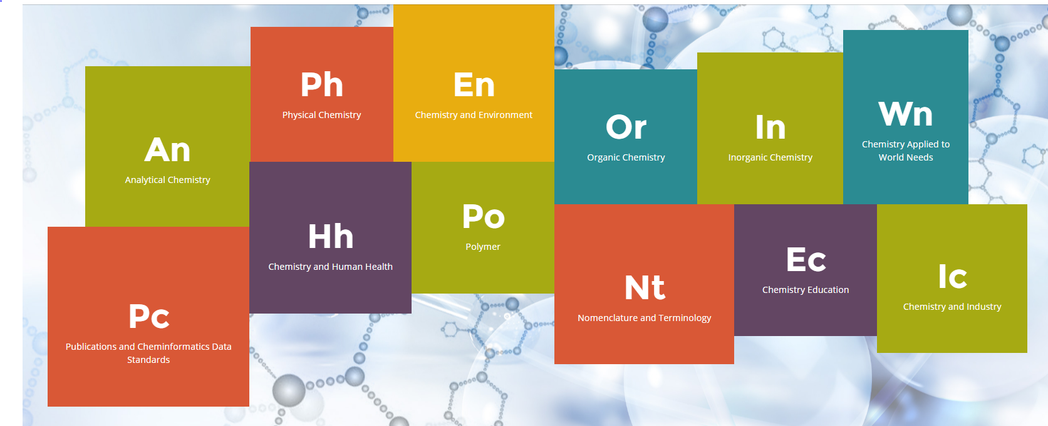
Scientific Work of IUPAC
Fields of Study
Notes:
The fields of Chemistry and focus areas of IUPAC’s volunteers

Slide 16
IUPAC’s Scientific Work
Divisions and Standing Committees–
Physical & Biophysical Chemistry
Inorganic Chemistry
Organic & Biomolecular Chemistry
Polymer Chemistry
Analytical Chemistry
Chemistry & the Environment
Chemistry & Human Health
Chemical Nomenclature & Structure Representation
Committee on Chemistry and Industry (COCI)
Committee on Chemistry Education (CCE)
CHEMRAWN Committee
Committee on Publications and Cheminformatics Data Standards (CPCDS)
Interdivisional Committee on Terminology, Nomenclature and Standards (ICTNS)
Notes:
Or, in a traditional format, the list…I prefer to use the Fields of Chemistry from the website, so that people know where they can look quickly at all that IUPAC does.

Slide 17
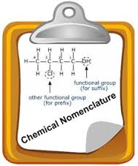
Primary IUPAC Activities
Development of the Language of Chemistry
  Nomenclature, Symbols, Terminology
Standardization of Chemistry Methods
  Data Presentation
  Study of Analytical Methods
Critical Evaluation of Physico-Chemical Data
  Atomic Weights
  Thermodynamic Data
  Kinetic Data

Slide 18
Primary IUPAC Activities (Cont.)
Data Exchange Standards for Computers and Instruments
Endorsement of International Conferences
  Biennial IUPAC Congress
    San Juan, Puerto Rico (2011), Istanbul, Turkey (2013), Busan, Korea (2015), Sao Paulo, Brazil (2017), Paris, France (2019)
  More than 30 Specialized Symposia each Year
Chemistry Education
Industrial Safety and Environmental Programs
CHEMRAWN Conferences addressing Chemistry and World Needs
Notes:
Too much text on this slide.

Slide 19
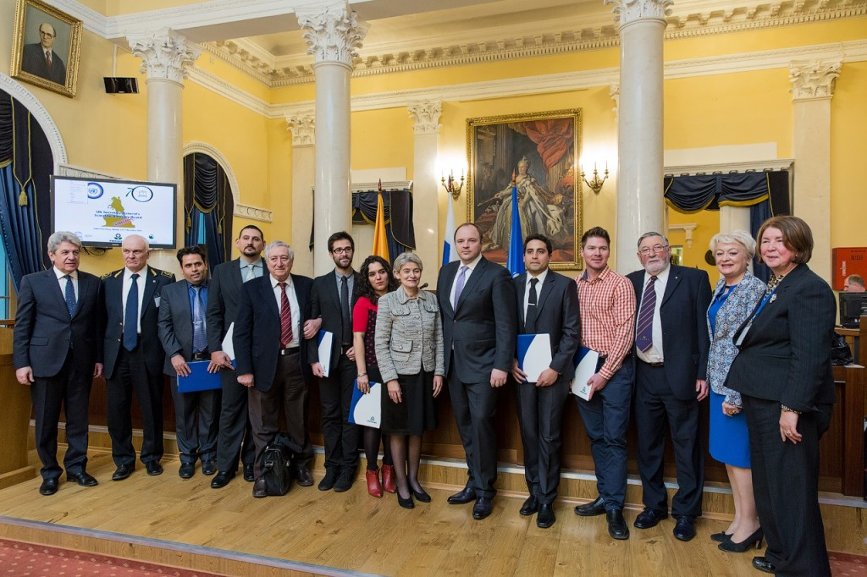
IUPAC operates a Project system
Anyone with a good idea can submit a project proposal.
IUPAC project funding is to facilitate the work of volunteers
  Highly leveraged (total IUPAC annual budget only $1.25 M
We have and accept funding in support of this work but retain scientific responsibility e.g.:
  IUPAC-Solvay Prize for Young Chemists
  PhosAgro Green Chemistry awards (UNESCO)
  Safety Training Program
  International Year of Chemistry 2011
  IUPAC Centenary 2019
Notes:
Possible image for this information? Reduce text?

Slide 20
Proposals for Projects
IUPAC projects address issues of significance to the general chemistry community:
  Nomenclature, terminology, and symbols
  Validated and compiled data
  Standard methods and procedures
  Education and public understanding of chemistry
  Any subject that requires development of consensus among chemists worldwide
More information: www.iupac.org/projects

Slide 21
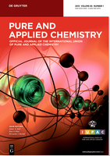
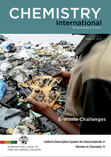
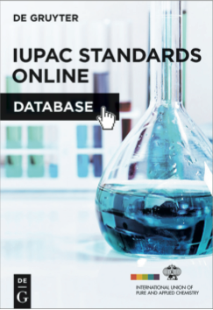

Results-
IUPAC’s Publications
Pure and Applied Chemistry (PAC)
Chemistry International (CI)
IUPAC Standards Online (2016)
Responsible Care Manual

Slide 22
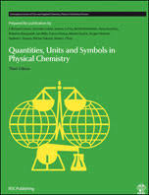
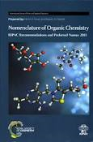
Results-
IUPAC’s Color Books
Chemical Terminology | Gold Book
Quantities Units and Symbols in Physical Chemistry | Green Book
Nomenclature in Organic Chemistry | Blue Book
Compendium of Polymer Terminology and Nomenclature | Purple Book
Analytical Terminology | Orange Book
Biochemical Terminology | White Book
Nomenclature in Inorganic Chemistry | Red Book
Compendium of Terminology and Nomenclature of Properties in Clinical Laboratory Science | Silver Book

Slide 23
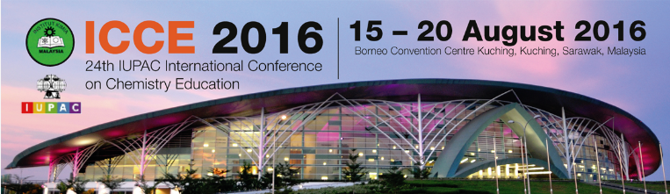
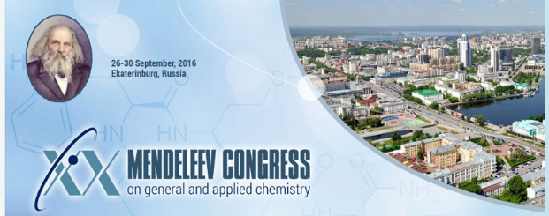
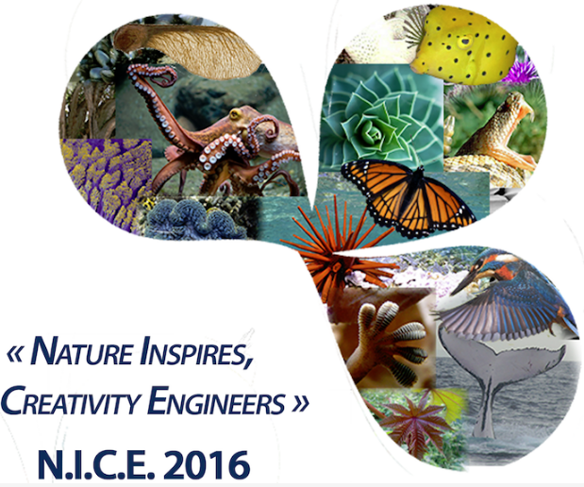
IUPAC Endorsed Conferences/Events
Notes:
Conferences are endorsed by IUPAC through a rigorous review process to insure that they meet IUPAC’s expectations. Held in our NAO countries. We also provide financial support through our Financially Supported Conference program in emerging countries and emerging chemistry fields.

Slide 24
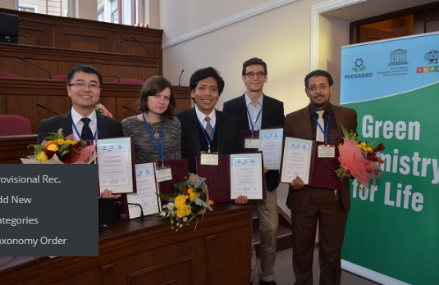
Scientific Awards Programs
IUPAC-Solvay International Award for Young Chemists
PhosAgro/UNESCO/IUPAC Green Chemistry for Life Grants Program
DSM Materials Sciences Award
2017 Distinguished Women in Chemistry or Chemical Engineering
Hanwaha-Total IUPAC Young Scientist Award
ThalesNano Prize for Flow Chemistry
CHeMRAWN VII Prize for Green Chemistry
Polymer International-IUPAC Award
IUPAC International Award for Advances in Crop Protection Chemistry
https://iupac.org/category/awards/

Slide 25
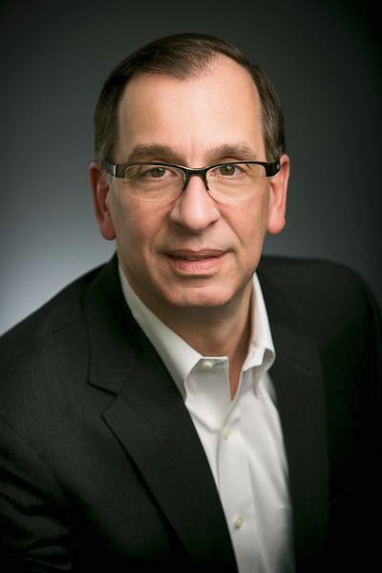
IUPAC-Richter Prize in Medicinal Chemistry
Established in 2006. Acknowledges the key role that medicinal chemistry plays toward improving human health
$ 10,000 awarded every two years to an internationally recognized scientist whose accomplishments demonstrate an outstanding level of contribution to the practice of medicinal chemistry or drug discovery.
2016 Prize was awarded (01 March 2016) to
Michael J. Sofia, Ph.D. In recognition of
outstanding contributions to the invention,
discovery and development of the novel
antiviral drug sofosbuvir (SovaldiTM)
as a treatment for the cure of hepatitis C.

Slide 26
IUPAC Responsible Care Book
  The context and history of the development of Responsible Care
  The Core Principles and why these are as relevant today and for the future
  The benefits and challenges of implementing Responsible Care
Two Case Studies:
  The benefits and challenges of successful implementation in Sulco Chemicals Ltd Canada
  Responsible Care in the chemical supply chain – avoiding tragedies such as occurred in cough mixture in Haiti

Slide 27
IUPAC Safety Training Program (STP)
An HSE capacity building program
Voluntary agreement of companies to train influential individuals from developing countries
Objectives
  To promote interactions between developed countries and the developing world
  To disseminate state-of-the-art knowledge on safety and environmental protection in chemical production and use.

Slide 28
STP FELLOWS SINCE 2000
2000 Ms. Esma Toprak Bogazici University Istanbul BP Chem. USA
Prof. El-Emam Mansoura University Cairo Bristol-Myers USA
2002 Mr, Tersoo Gwaza Shell Petrochem Nigeria SASOL SA
Mr. Guohong Zhang SINOPEC China BP Chem USA
Mr. Kelvin Khisa UNIDO Nairobi Sankyo Japan
2003 Ms. Jane Nyakang'o UNIDO Nairobi BP Chem USA
Ms. Luisa Arocena CEMPRE Uruguay BP Chem USA
2004 Mr. Bakare Isiaka Rubber Institute Nigeria Mitsui Chem Japan
2005 Prof. S Bayomi Mansoura University Cairo AstraZeneca UK
2007 Prof. Fabian Benzo Montevideo University Uruguay Mitsui Chem. Japan
Dr. Godfred Nyarko Tema Lube Oil Co. Ghana Mitsui Chem. Japan
2008 Dr. Gursharn Grover National Research Council India Novozymes Denmark
2013 Prof. Jonathan Babalola Ibadan University Nigeria Dow Benelux
Mr. John Mumbo Environment Authority Kenya Dow Benelux
2014 Eng. Noha Elbalky FEI-ECO Cairo Woodbridge Canada
2015 Prof. Ahmed Youssef Cairo University Cairo Bayer Crop Science USA
Ms. Christine Ashaolu Regulatory Agency Abuja Nigeria National Silicates Canada

Slide 29
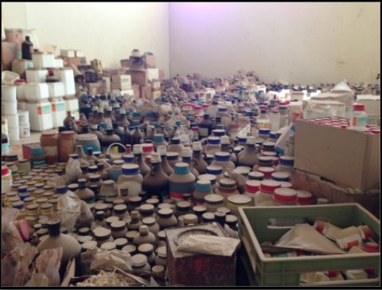
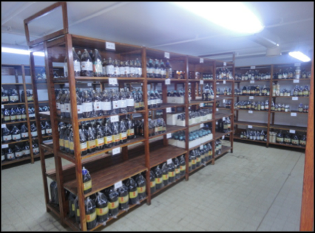
Professor Youssef project
Chemicals storage in North African Universities
After
Before

Slide 30
IUPAC Current Interests
Notes:
Where is IUPAC focusing for the future???

Slide 31

IUPAC Issues for Today
UN Sustainable Development Report
ADVANCING CHEMISTRY WORLDWIDE
UN call for projects in support of its Sustainable Development Goals Q1 2017
IUPAC project to address this
Creation of an interdivisional Sub-Committee on Green and Sustainable Chemistry approved

Slide 32
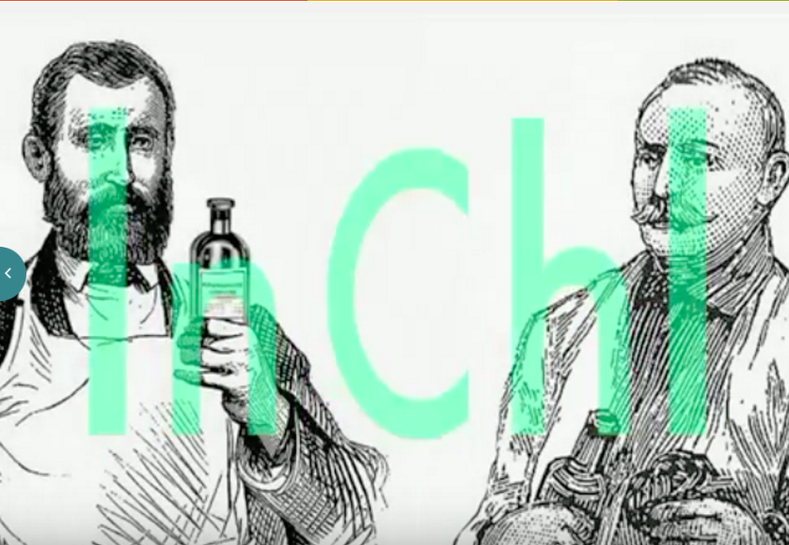



IUPAC Issues for Today
Big Data, Data Sharing, Standards & Machine Exchange
ADVANCING CHEMISTRY WORLDWIDE
http://www.inchi-trust.org/
Project: 2015-019-2-800
QR Codes
IUPAC International Chemical Identifier (InChITM)
http://www.icsu.org/science-international/accord
ICSU Big Data

Slide 33

IUPAC Issues for Today
Strategic Approach to International Chemicals Management (SAICM)
Is a policy framework to promote chemical safety around the world.
Key Initiative by UN through UNEP and WHO
IUPAC sees a role for an authoritative, independent, science input
Currently reviewing IUPAC projects on green and sustainable chemistry as an input and reviewing the international chemistry approach to the new UN Sustainable Development Goals.
Seeking an efficient way to engage in SAICM process
Represented by Anna Makarova, Mendeleyev University of Technology

Slide 34

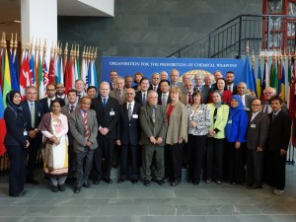

IUPAC Issues for Today
OPCW Ethical Guidelines
ADVANCING CHEMISTRY WORLDWIDE
IUPAC Endorsed
The production and use of chemicals is accompanied by recognition of the responsibility of chemists to ensure that they are applied solely for peaceful and beneficial purposes.
https://www.opcw.org/special-sections/science-technology/the-hague-ethical-guidelines/

Slide 35
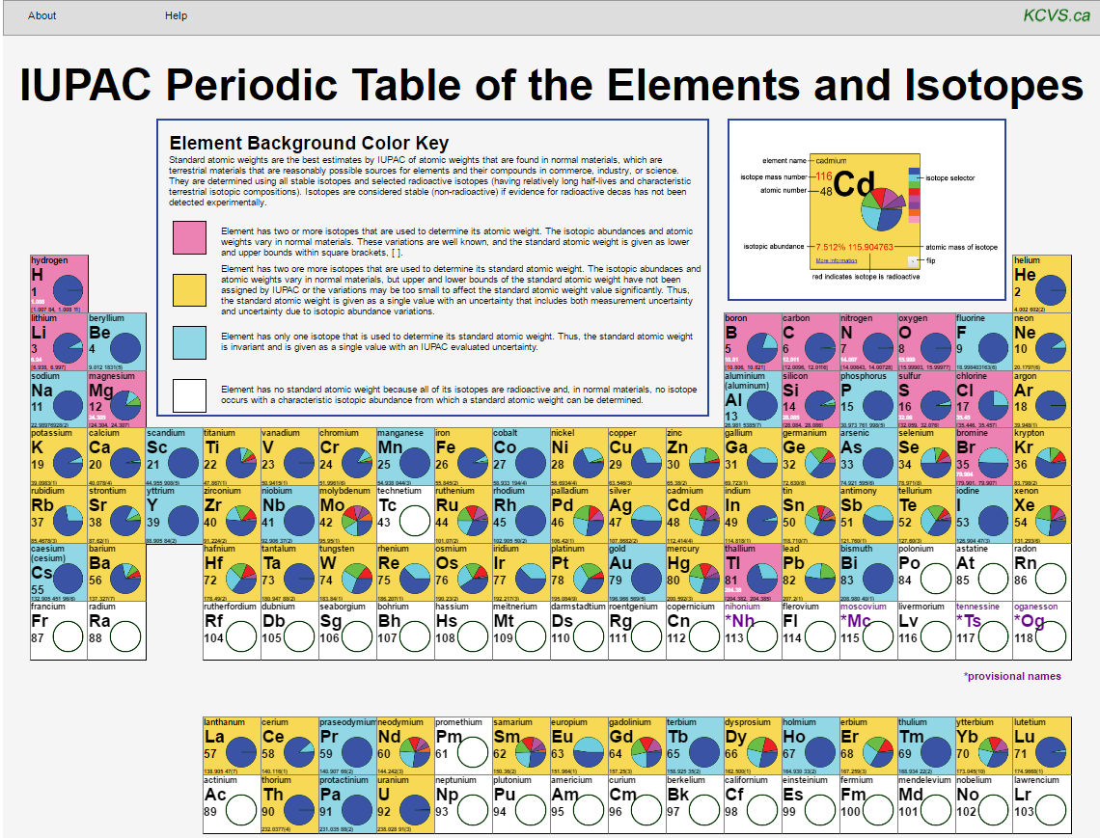

IUPAC Issues for Today
Bringing Science and Education Together
Peter Mahaffy/Norman Holden
www.isotopesmatter.com

Slide 36
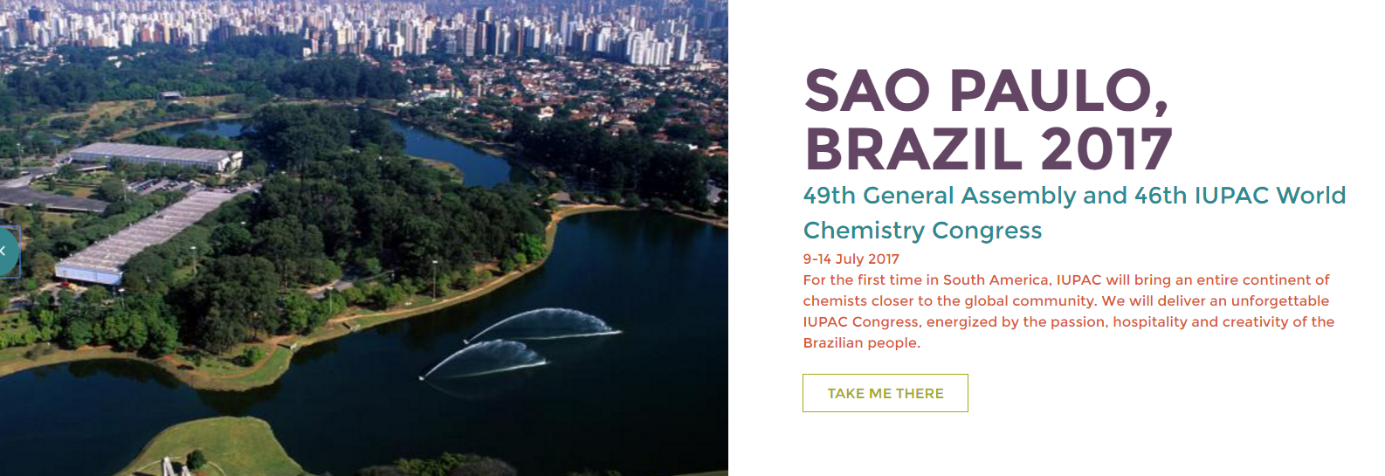
Come Join us for IUPAC2017
www.iupac2017.org
Cal
Bring your best and brightest to participate!

Slide 37
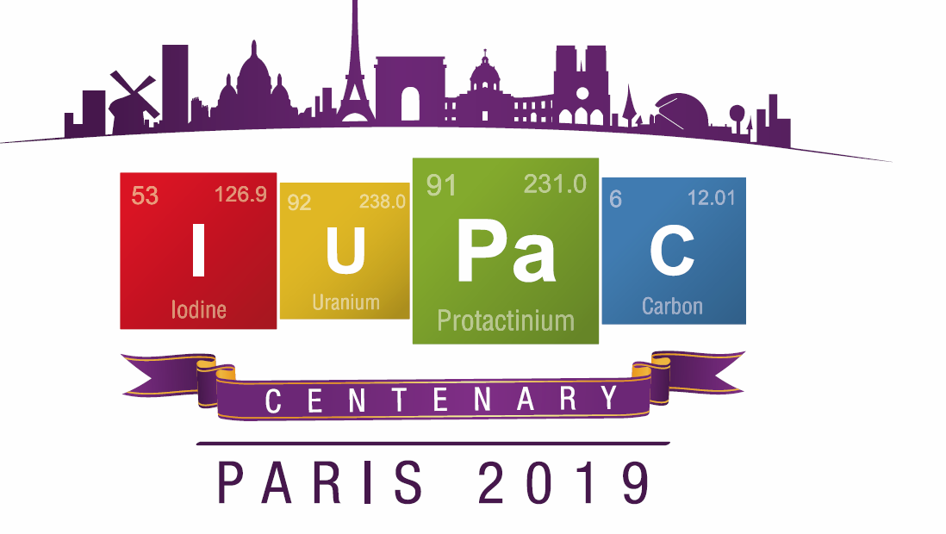
100 Years of IUPAC-Centenary Celebration
Also, the 150th Anniversary of the Periodic Table of the Elements

Slide 38
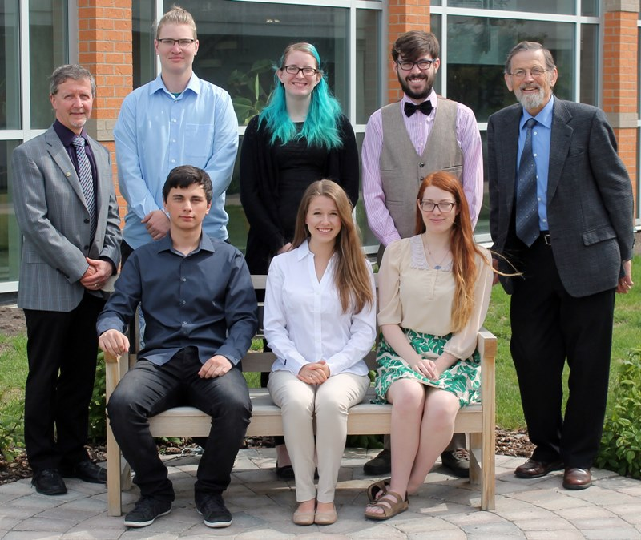
Encourage and Mentor the Best and Brightest for the Future and Collaboration on Global Scale
and background, recruited by transparent and well-understood processes.
Young Chemists
IYCN
Young Observers
Notes:
Call to Action: (LMS)
worldwide base of volunteers with the best skills and background, recruited by transparent and well-understood processes.

Slide 39
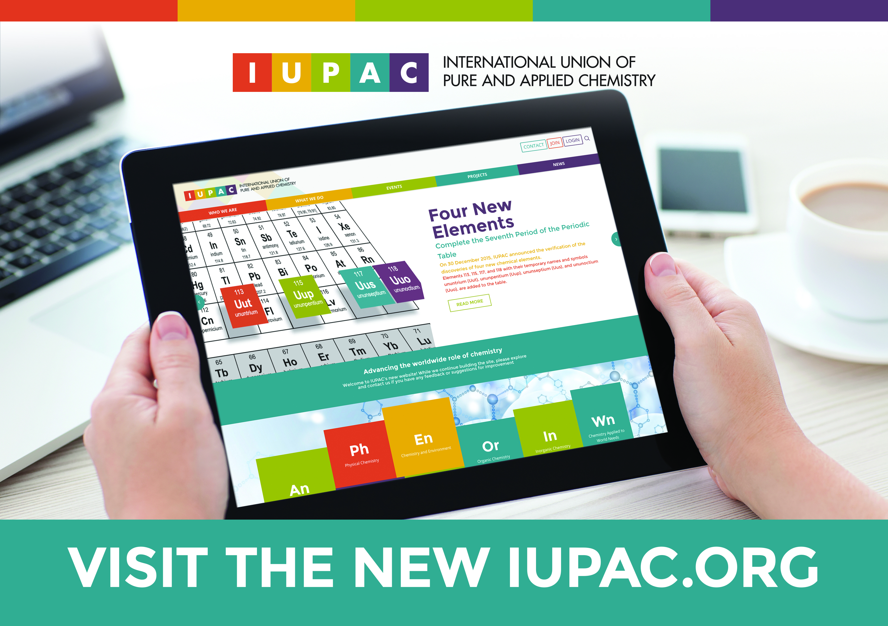
Connect with us and learn more at www.IUPAC.org
Current IUPAC Projects
Member Directory
Reports and Recommendations
Chemistry International eTOC
Conference and Events Calendar
Nomenclature and Terminology
Governance

Slide 40

The IUPAC Secretariat
Research Triangle Park, North Carolina
Notes:
The Secretariat Staff supporting the work of IUPAC’s volunteers, from left to right: Jay Lucido (Financial Controller), Dr. Lynn Soby (Executive Director), Enid Weatherwax (Administrative Assistant), Linda Tapp (Membership Manager) and Dr. Fabienne Meyers (Managing Editor, Chemistry International and Associate Director.

Slide 41
Thank you for Advancing Chemistry World Wide with IUPAC

Slide 42
Backup Slides for Use

Slide 43
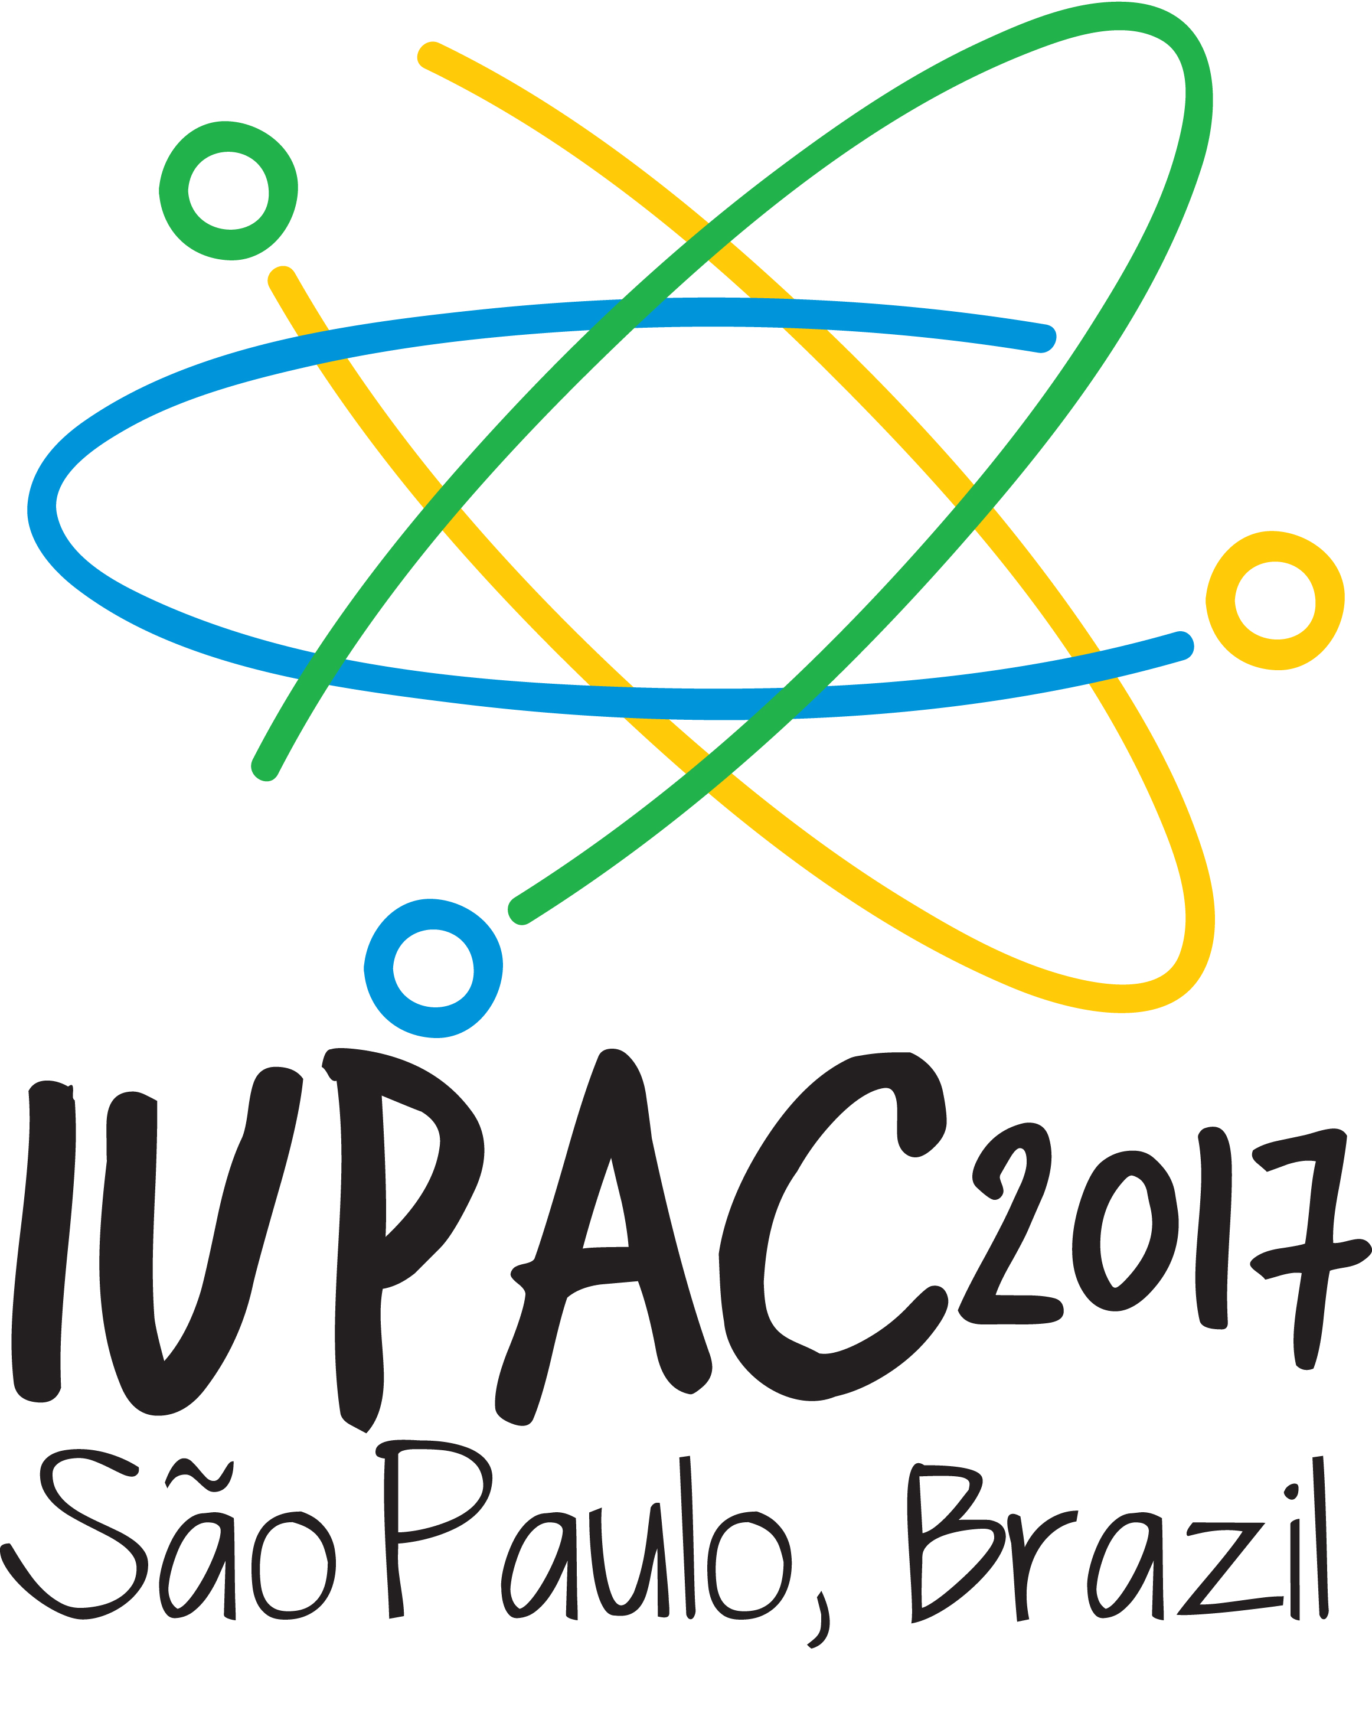
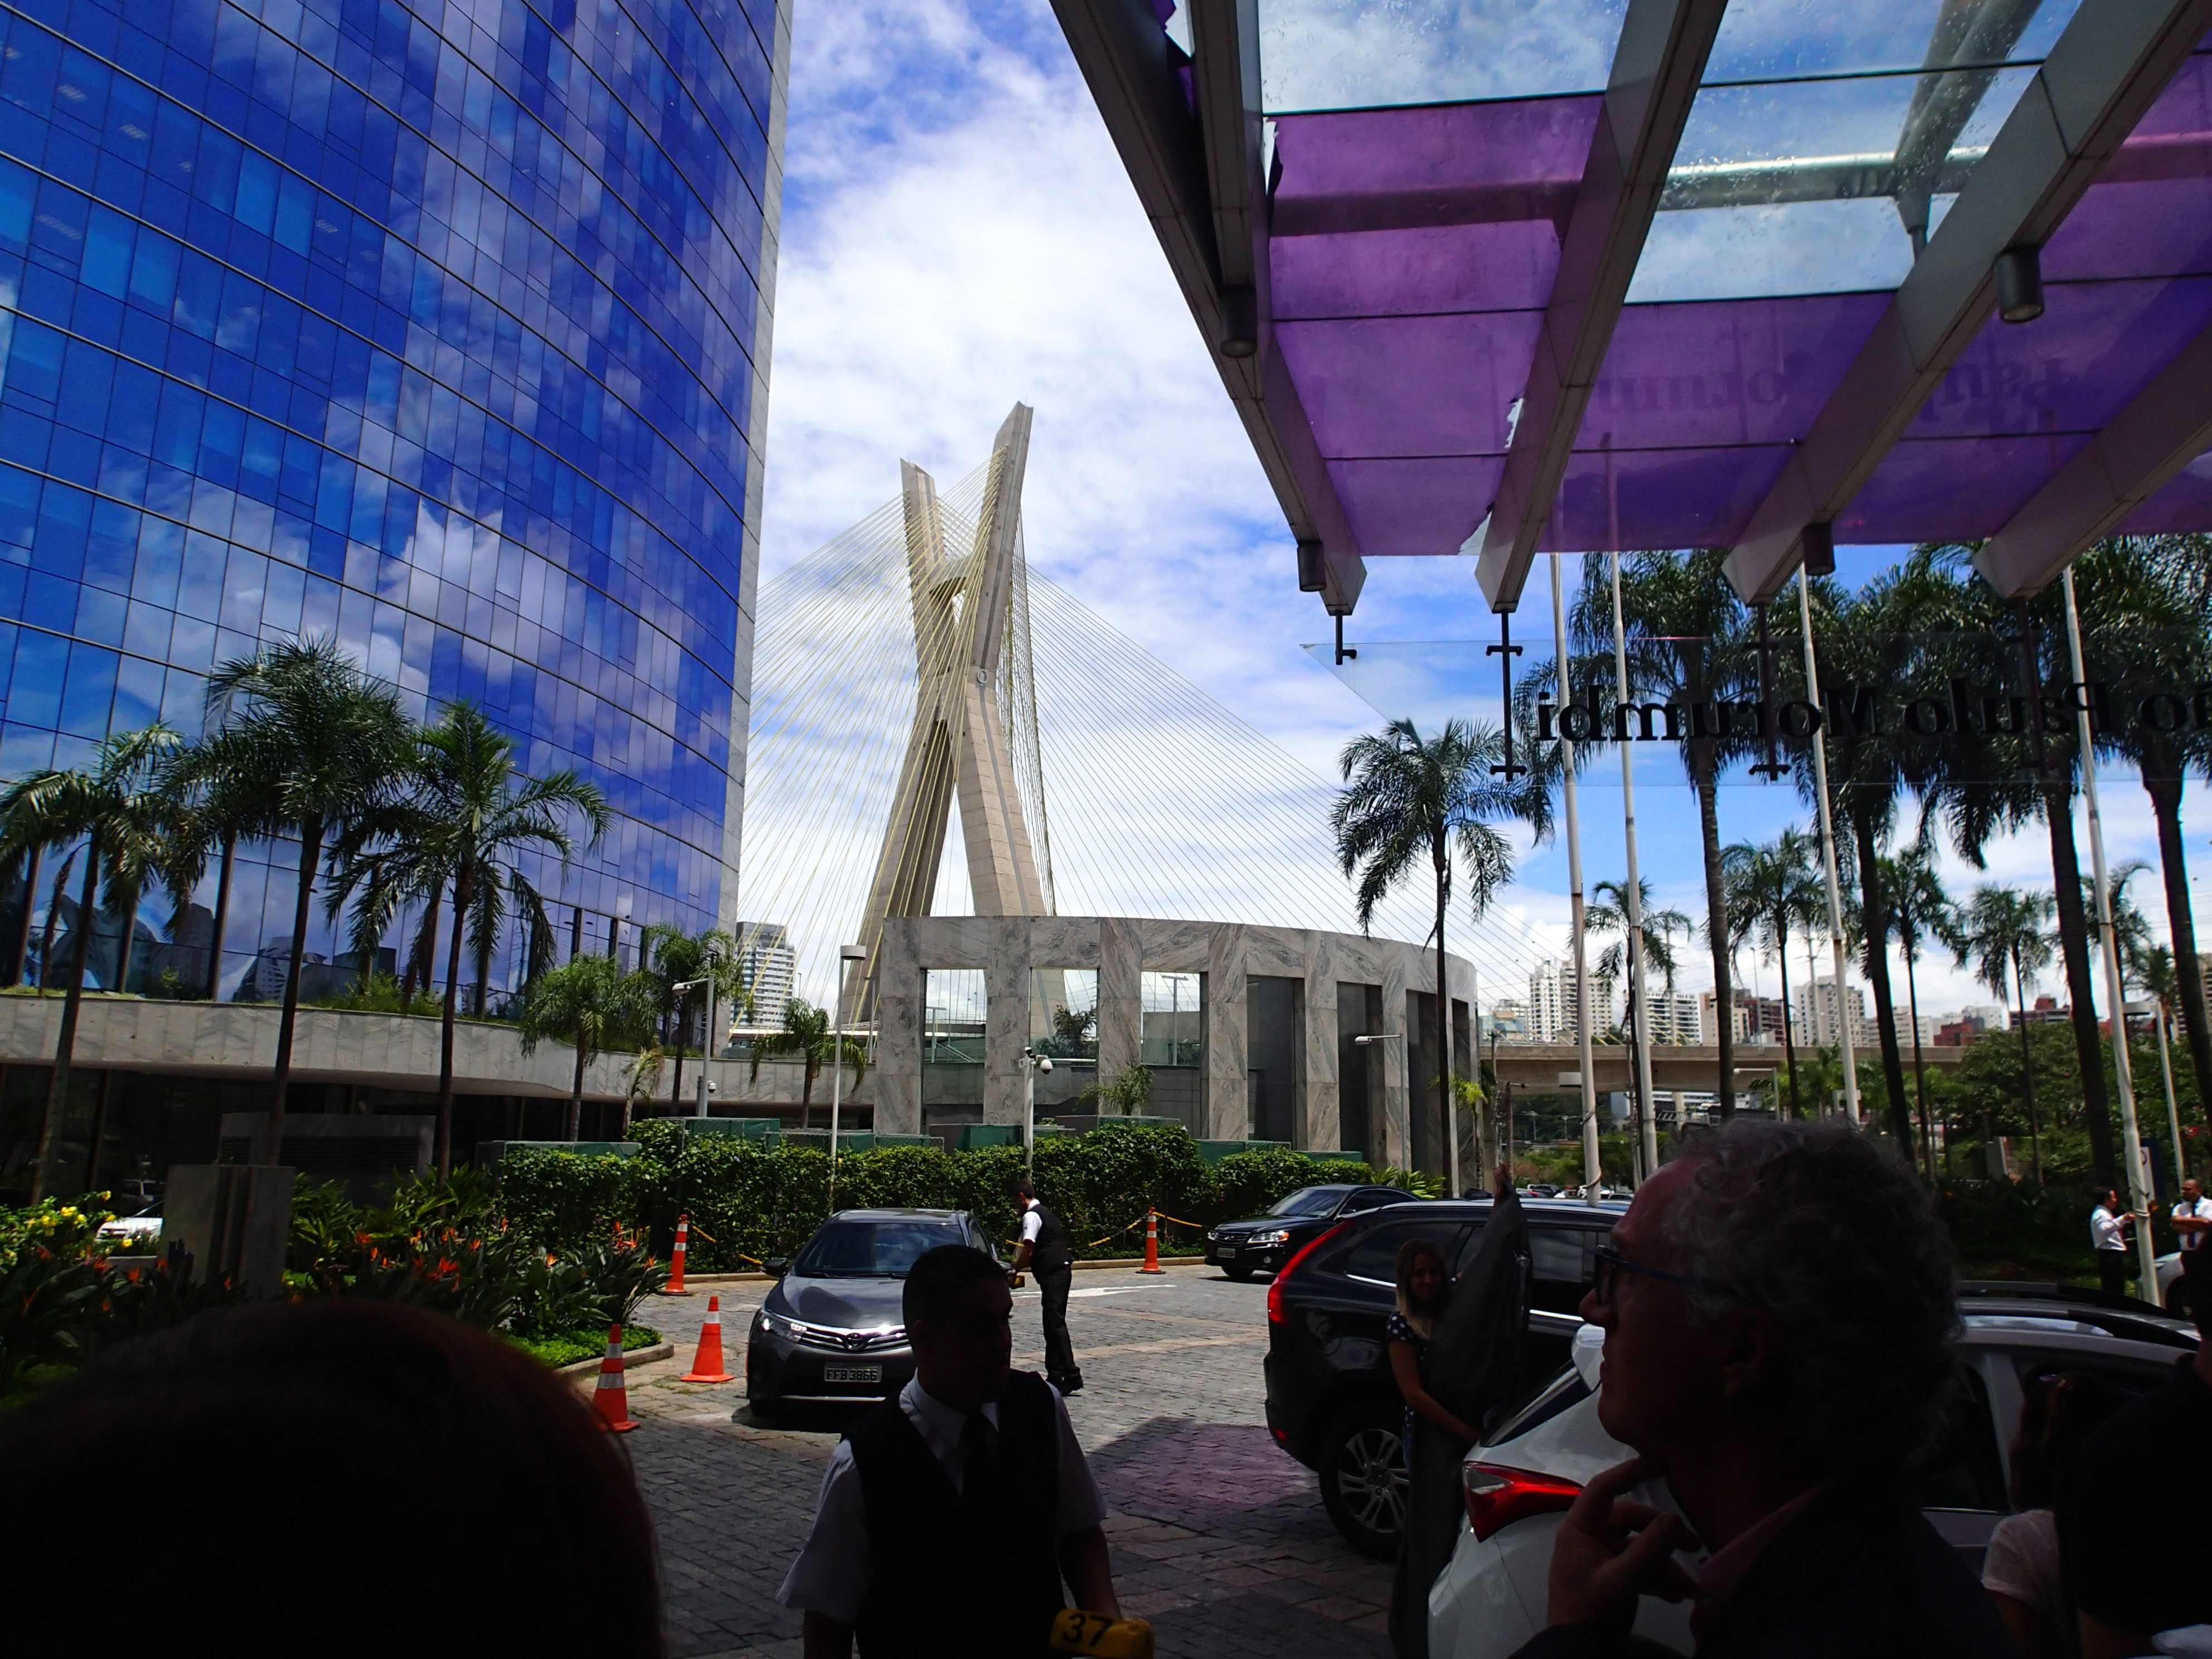
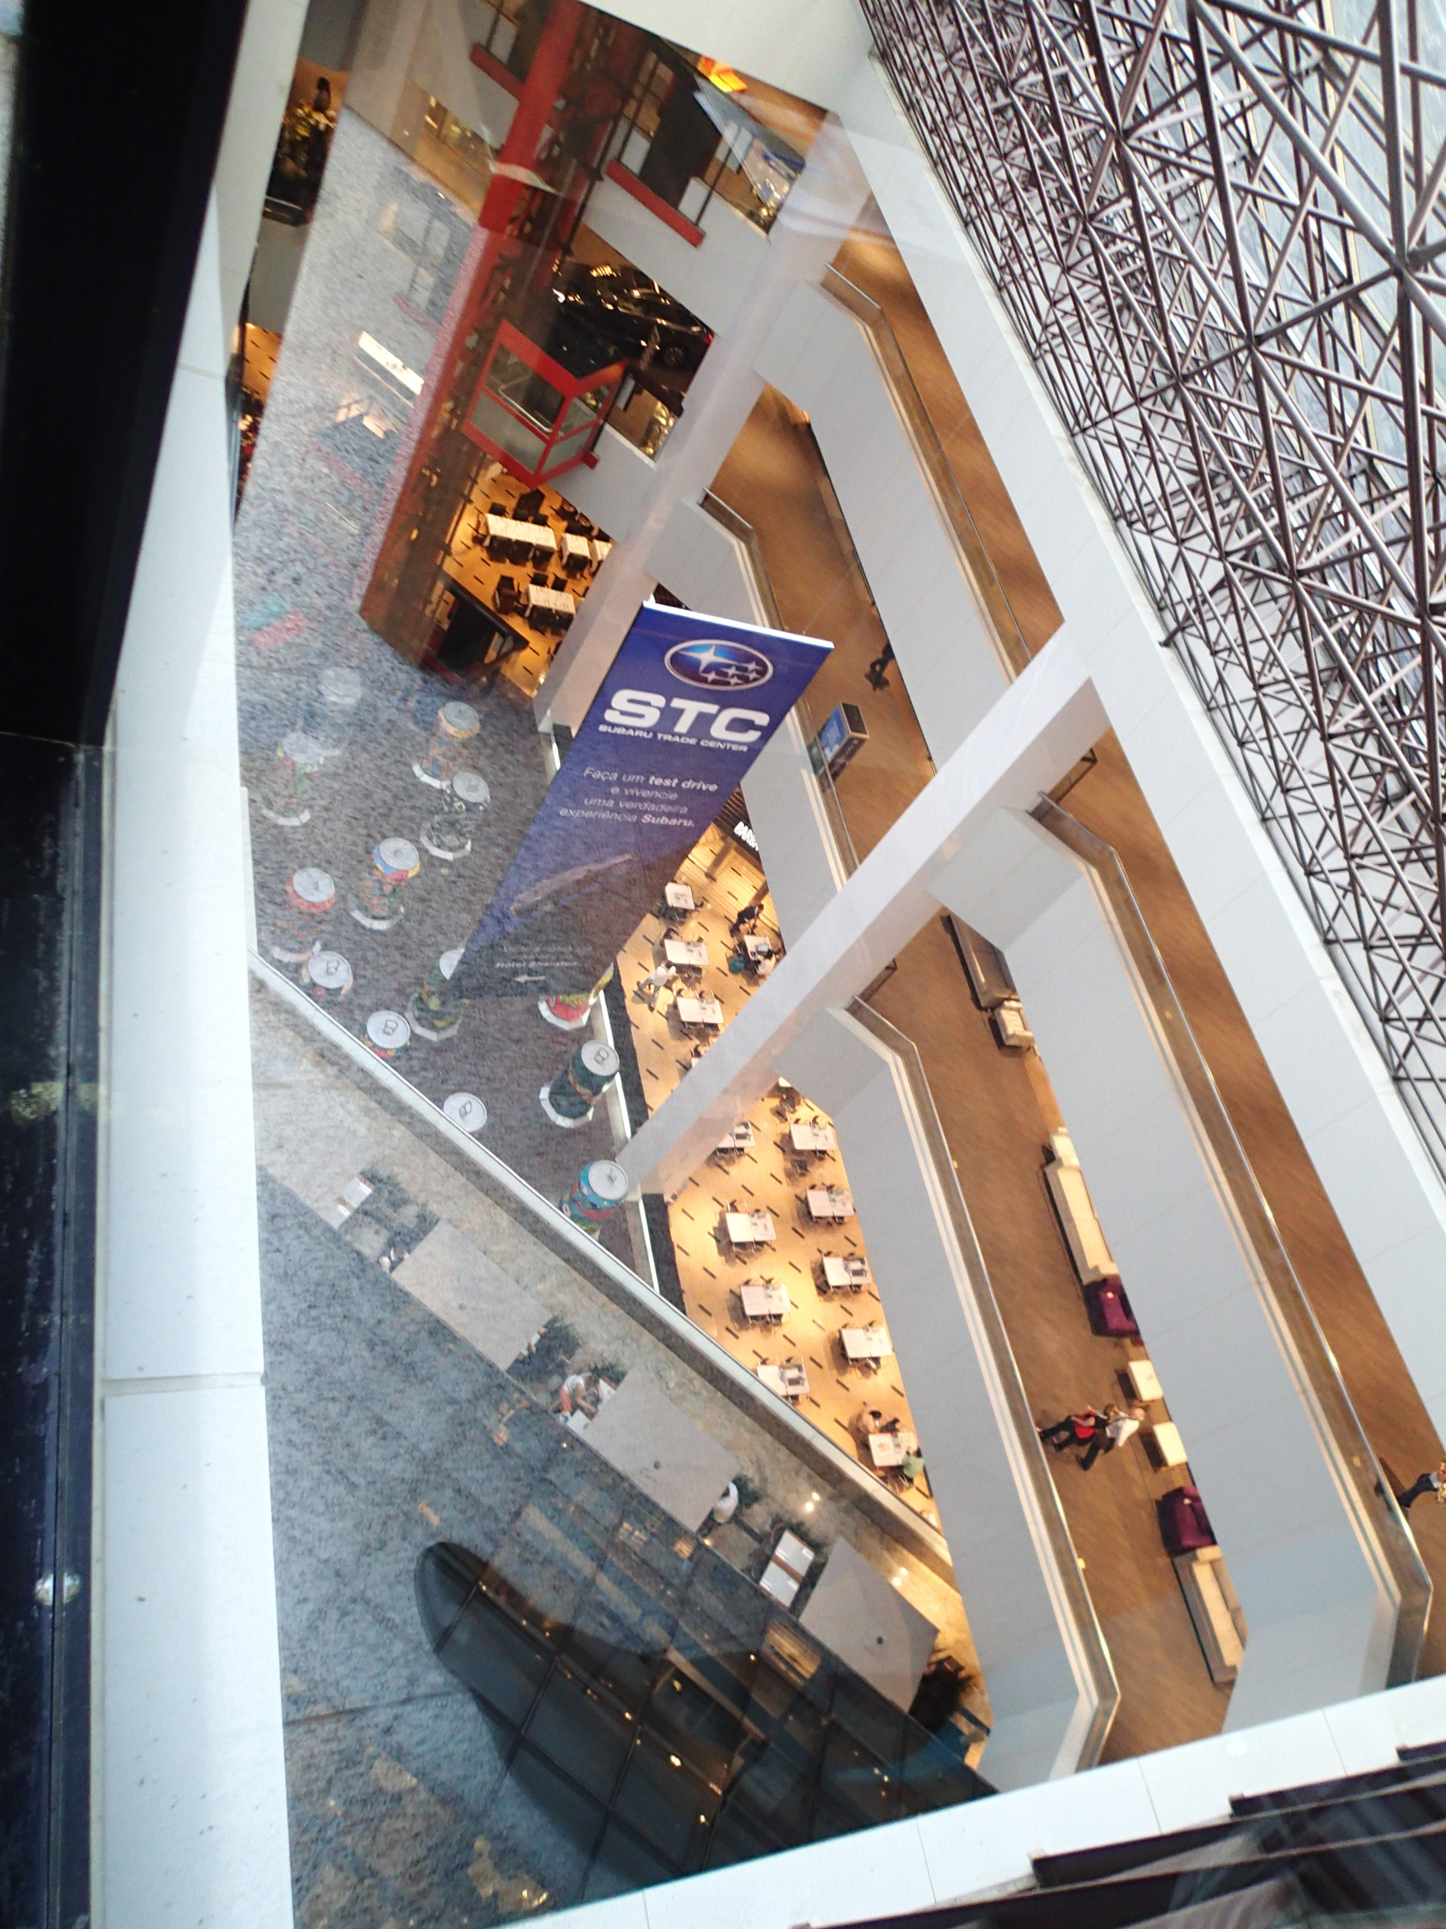
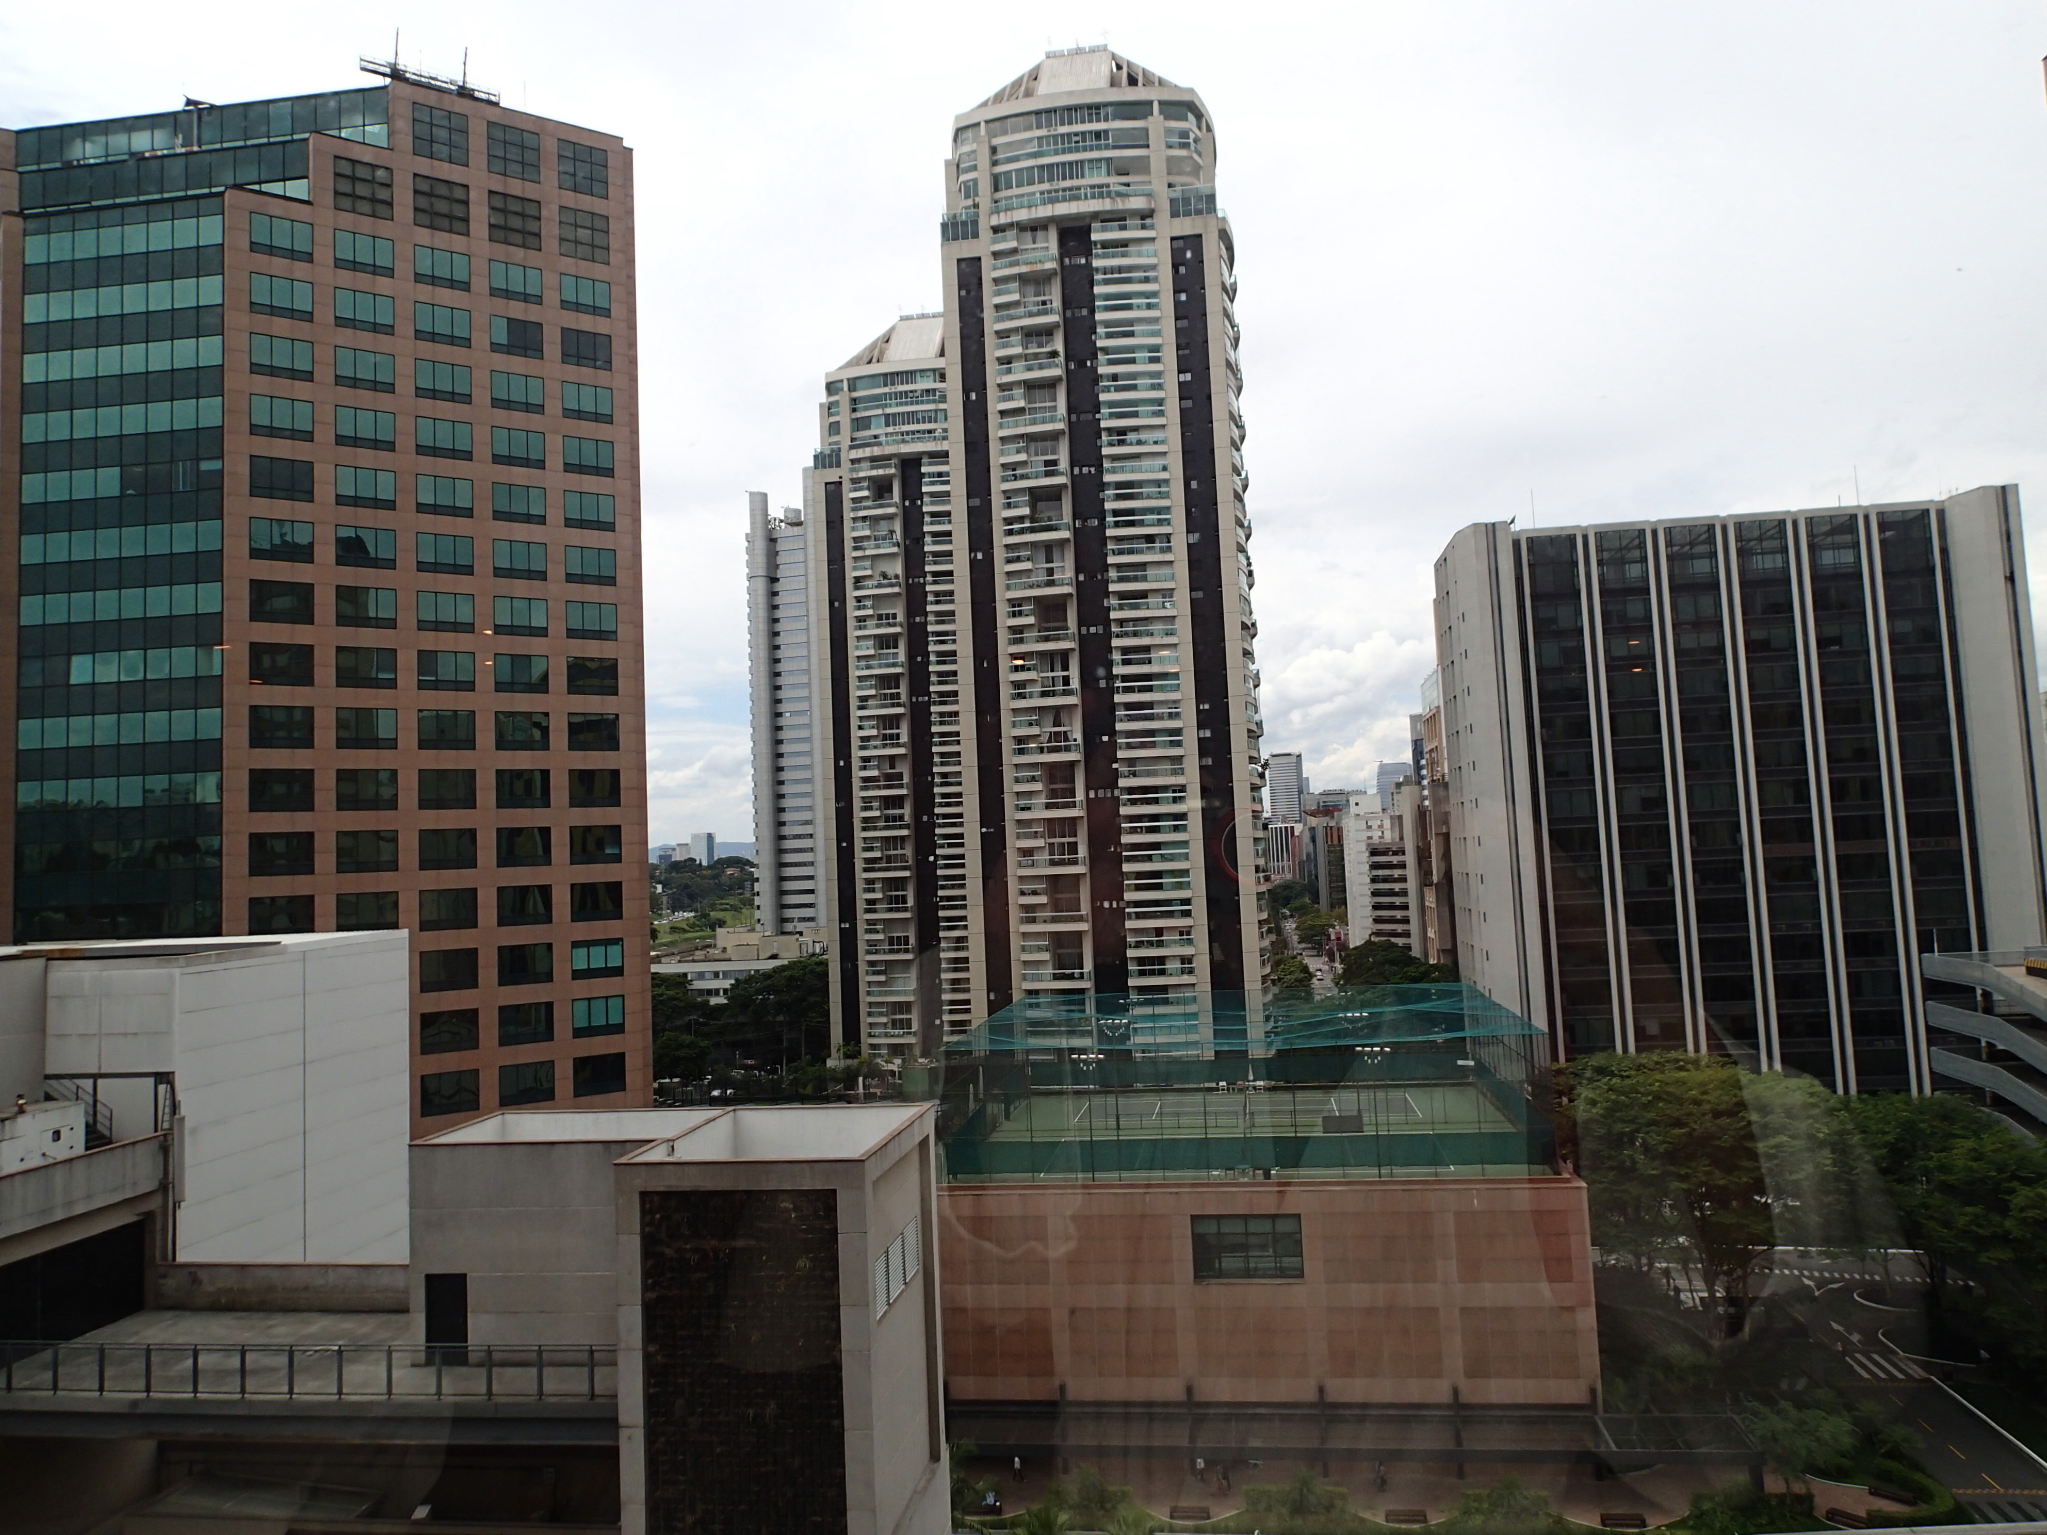
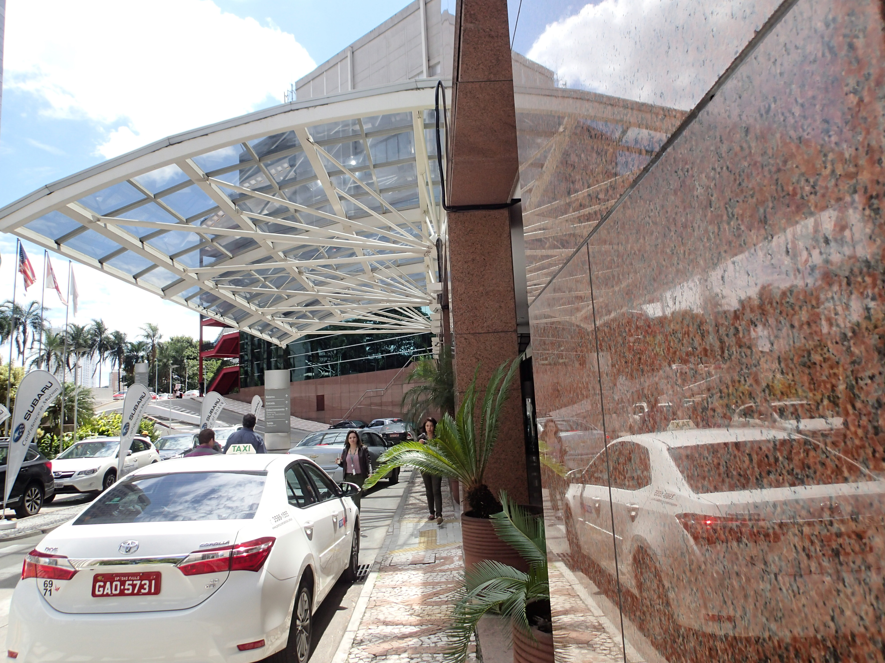
Sheraton WTC Venue
IUPAC2017 Venue: Full use of facility for Congress and General Assembly attached to the Sheraton WTC Hotel (Bureau)

Slide 44
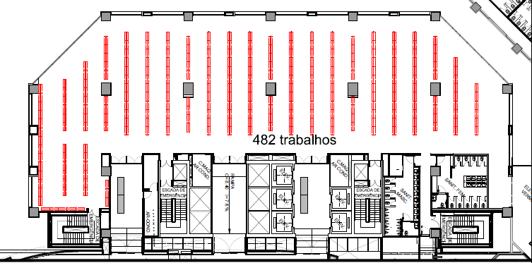
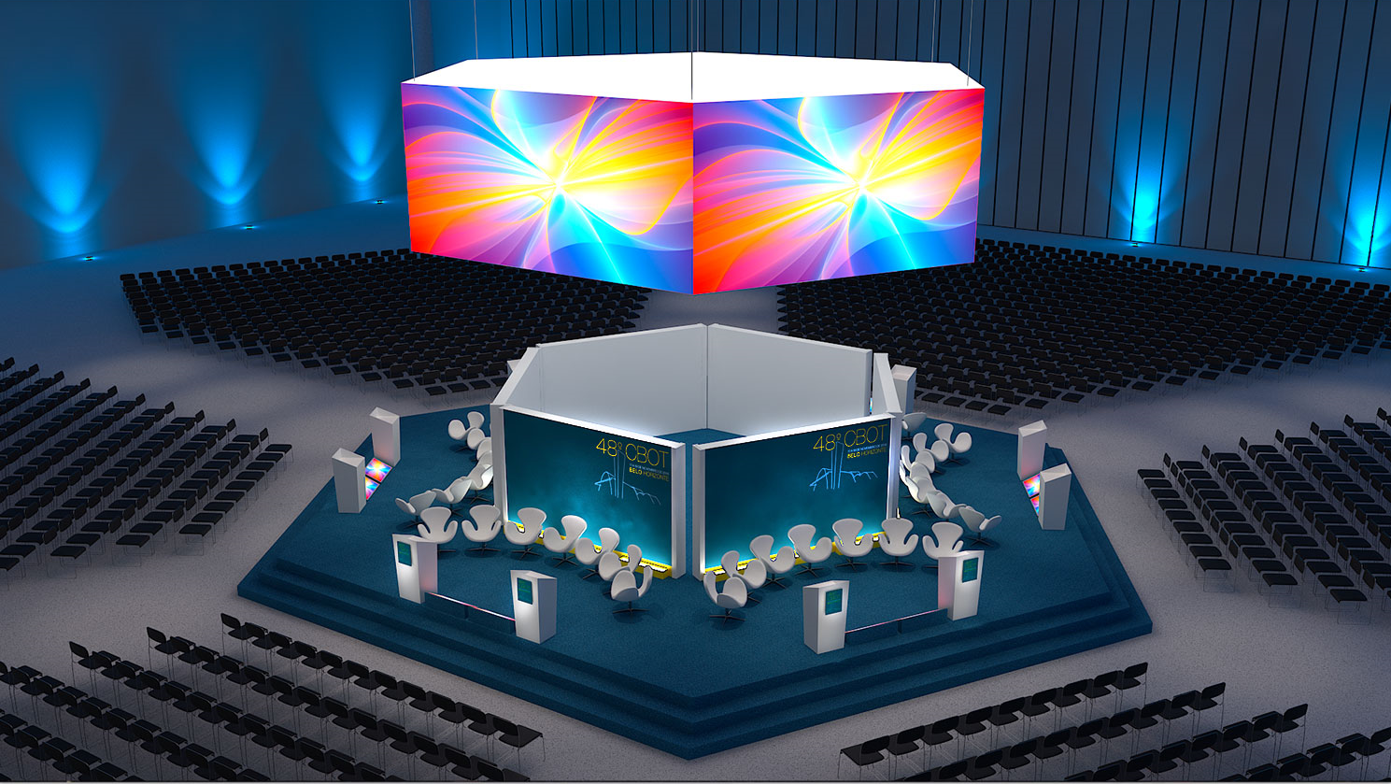
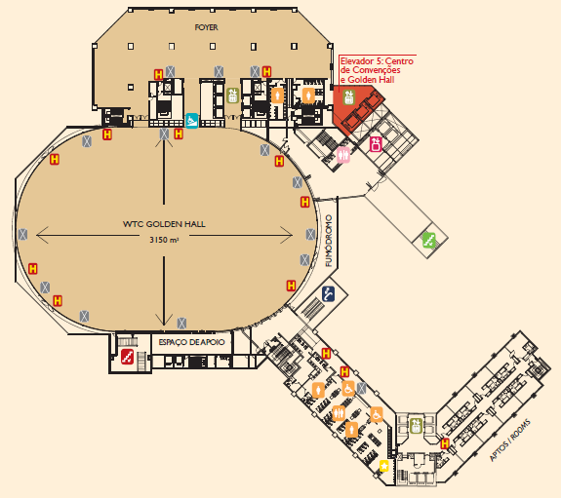
Sheraton WTC Venue
IUPAC2017 Venue: Symposia Venue and Poster Sessions
ENTRANCE
OF DELEGATES

Slide 45
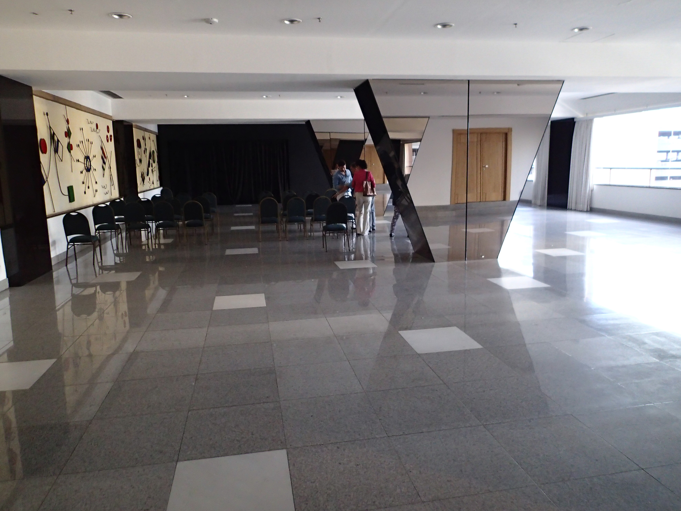
IUPAC Congress/GA
Planning Status
Prof. Dr. Noberto Perporine Lopes replaced Prof. Luiz Silva
World Chemistry Leadership Meeting: Co-Chairs Hemda Garelick and Christopher Ober (Volunteered at Bureau meeting in April 2016)
  Centered around Interdisciplinary Materials-Green-Sustainable
  Incorporation of Young Observers and IYCN (new)
Division VI Chemistry and the Environment (Hemda Garelick)
  Collaborating with organizers for 3 ½ day symposia
  Environment Chemistry Poster Award
Division IV Polymer DSM Award
  Changing venue to coincide with Macro2018 (in process)

Slide 46
IUPAC Congress/GA
Planning Status-Special Symposia
Women in Science Award & Symposia-Angela Wilson/Carolyn Ribes
  Scheduled for Tuesday PM
Young researchers in chemistry (Thursday or Sunday before the beginning of the IUPAC meeting)
Commemorative Symposium of SBQ 40th Anniversary (Wednesday afternoon)

Slide 47
The IUPAC-Solvay Award for Young Chemists
Established to encourage young research scientists at the beginning of their careers.
Awarded for the most outstanding Ph.D. theses in the general area of the chemical sciences.
Next Deadline: 31 January 2017

Slide 48
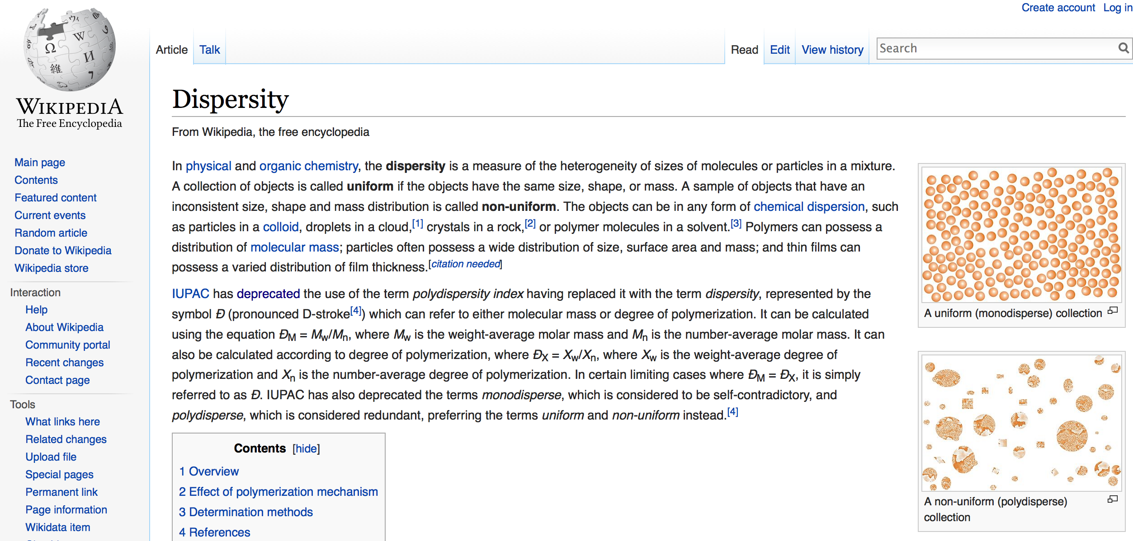
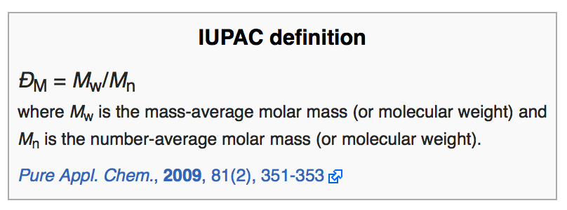
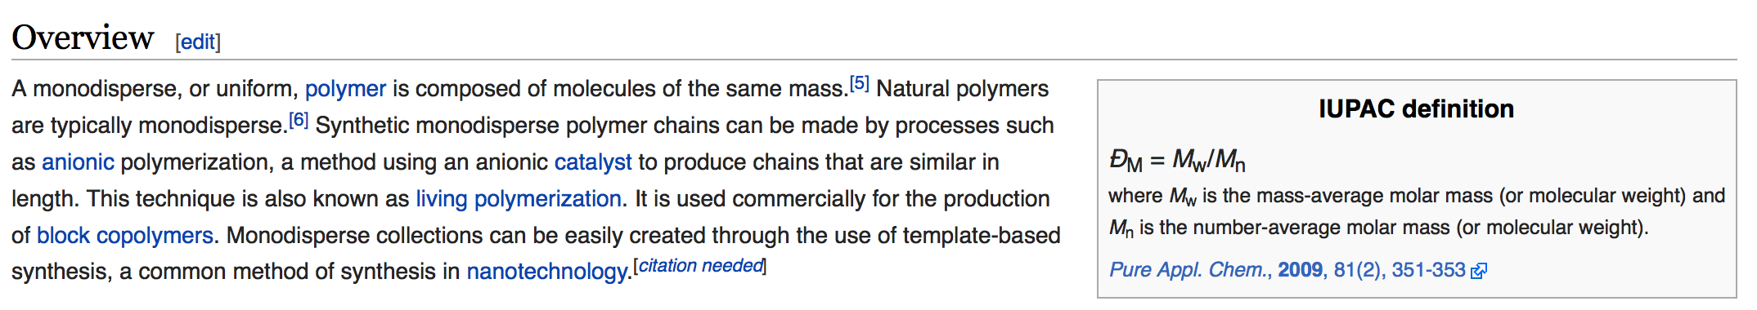
Wikipedia Correctness

Slide 49
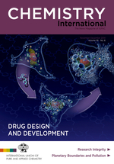
Affiliate Membership Program
Individuals may become affiliated with IUPAC through the Affiliate Membership Program (AMP).
Benefits Include:
  Subscription to bimonthly magazine, Chemistry International
  Discounts on IUPAC Books and Pure and Applied Chemistry
  Registration discounts (10%) for most IUPAC-Endorsed Conferences
  Access to an international network of Chemists
Notes:
This is a different layout of how a title, content and image could be presented.

Slide 50
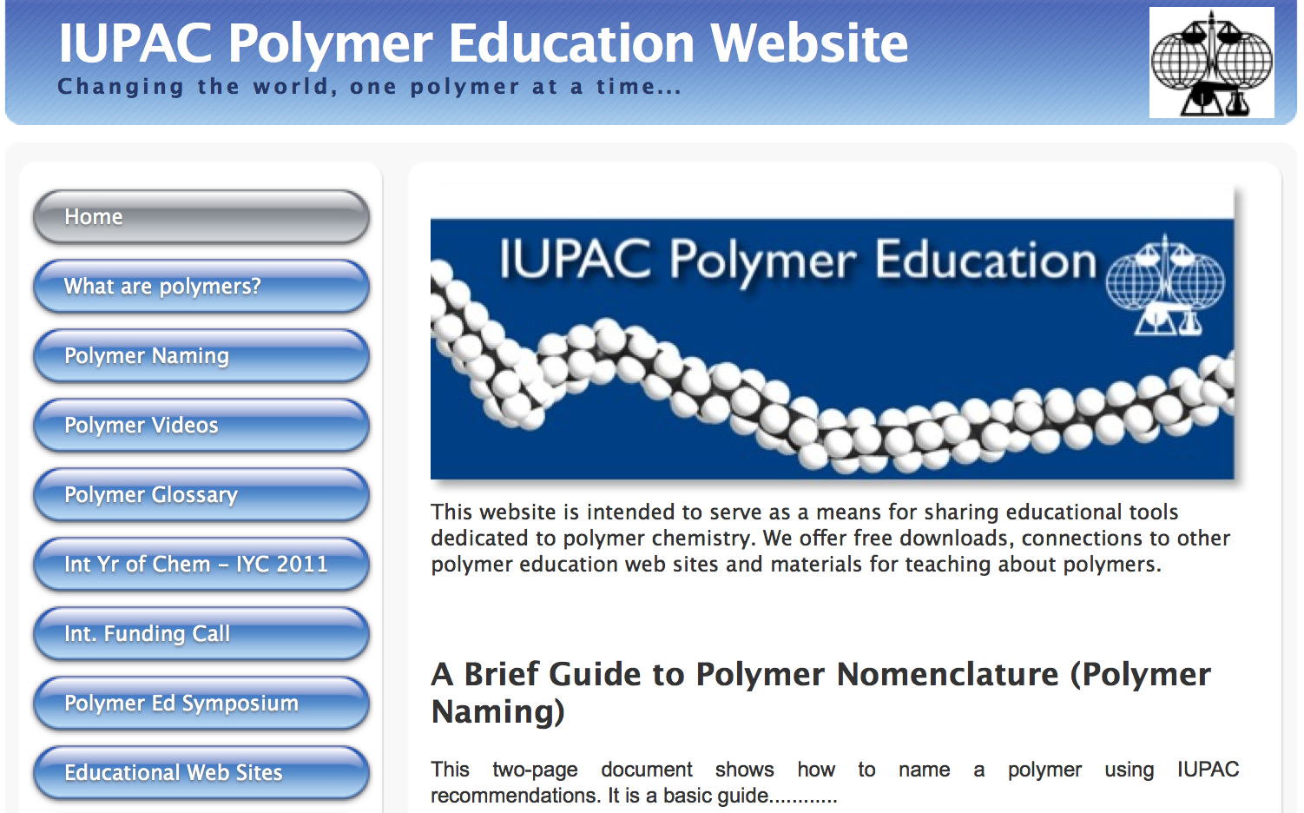
SPEd Snapshot 2: iupac.org/polyedu/
Notes:
From Chris Ober

Slide 51
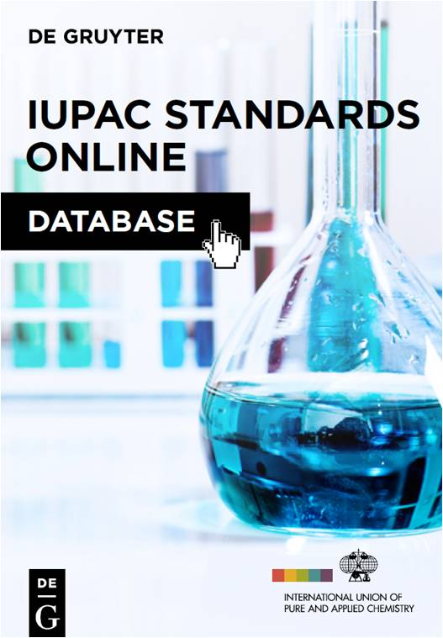
IUPAC Standards Online Database
Content: IUPAC Standards and Recommendations
Standard search criteria, features & functionalities
Advanced search capability/cross-linked entries
Quick and easy discovery, access and retrieval of IUPAC’s Standards and Recommendations
Launched March 2016!
Notes:
When De Gruyter assumed the publishing role for Pure and Applied Chemistry (PAC) they were given contractual rights to sell the PAC back files as an avenue for generating additional revenue. However, IUPAC allows that material to be accessed via open access. After much discussion on this issue, De Gruyter put forth a proposal in September of last year to create a database derived from the IUPAC Standards and Recommendations that are published in PAC. This would be a new revenue-generating opportunity for both IUPAC and De Gruyter even though the Standards and Recommendations are freely-available through the back file. De Gruyter believes that the database will make it much easier and quicker to locate and use the content, and that users will be willing to pay for this added-value.
Three database options were presented. After much discussion, CPCDS recommended that IUPAC start with the basic, core database that would be created by extracting the Standards and Recommendations from the PAC content that De Gruyter already has in house. An agreement in principal, pending the development of a mutually-satisfactory business plan, was reached in December 2014. While discussions on the business plan took place early in 2015, CPCDS worked in parallel with De Grutyer to develop search criteria, system features/functionalities, and the basic database tree structure (the framework for searching). This basic database will have what you expect from any database regarding search criteria, features and functionalities. There will be an advanced search capability and most entries are cross-linked so that you can retrieve the same information from different starting points. It is important to note that the database will not include all PAC content, only the Standards and Recommendations. Also, the content will be as of the immediate prior year (e.g. the most recent content in the 2016 database will be from 2015). The database will be updated annually with more frequent updates if the scientific content requires it.
The database production agreement was signed at the end of April 2015 and CPCDS continues to work with De Gruyter as the development work progresses. It should be noted that De Gruyter covered the cost of creating this initial database and that IUPAC will get a royalty on sales. IUPAC retained the right to upgrade the product if warranted by market acceptance
The launch will be in the first quarter of 2016. The Secretariat will have free access to use the database and to monitor its quality and CPCDS will monitor the success of the database and consider how the database could evolve into the enriched version if deemed appropriate.

Slide 52
IUPAC operates a Project system
Anyone with a good idea can submit a project proposal.
IUPAC project funding is to facilitate the work of volunteers
  Highly leveraged (total IUPAC annual budget only $1.25m p.a.)
We have and accept funding in support of this work but retain scientific responsibility e.g.:
  IUPAC-Solvay Prize for Young Chemists
  PhosAgro Green Chemistry awards (UNESCO)
  Safety Training Program
  International Year of Chemistry 2011
  IUPAC Centenary 2019
More information on 3rd Party funding: http://iupac.org/what-we-do/awards/ http://iyc2011.iupac.org/sponsors
Notes:
Possible image for this information? Reduce text?

Slide 53
IUPAC operates a Project system
Anyone with a good idea can submit a project proposal.
IUPAC project funding is to facilitate the work of volunteers
  Highly leveraged (total IUPAC annual budget only $1.25m p.a.)
We have and accept funding in support of this work but retain scientific responsibility e.g.:
  IUPAC-Solvay Prize for Young Chemists
  PhosAgro Green Chemistry awards (UNESCO)
  Safety Training Program
  International Year of Chemistry 2011
  IUPAC Centenary 2019
More information on 3rd Party funding: http://iupac.org/what-we-do/awards/ http://iyc2011.iupac.org/sponsors
Notes:
Possible image for this information? Reduce text?

Slide 54
Responsible Care in Africa
ADVANCING CHEMISTRY WORLDWIDE
Initiative of Chemical Industry (ICCA)
IUPAC partnering with ICCA/UNEP/OPCW
  IUPAC Responsible Care Book (tertiary education)
  IUPAC Safety Training Programme
  Educational programmes/ Pan African Network?
IUPAC participation in SAICM

Slide 55
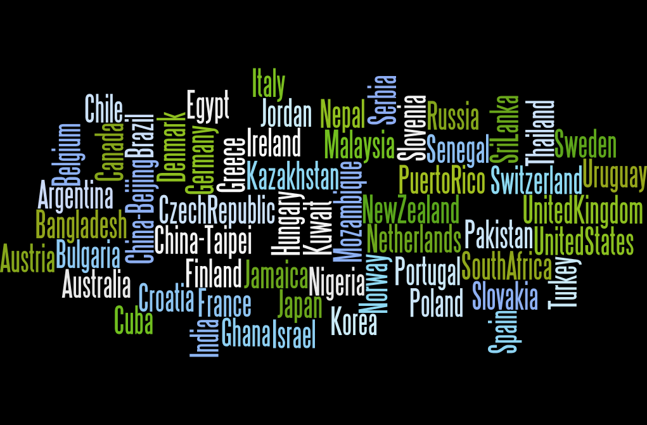
IUPAC 57 NAOs and 1 ANAO 2016-2017
Notes:
This was an image used in a sample powerpoint. The original had a title as part of the image, but it was off-centered and wouldn’t have looked nice. When possible, crop out something like that and use this template’s title text instead. Also, this image would look better if run the full width of the slide but we’ll need to rethink how to display the title.

Slide 56
Committee on Chemistry and Industry
Chair: Dr. Bernard West

Slide 57
Committee of Chemistry and Industry (COCI) Chair: Dr. Bernard West
Focus on Applied Chemistry – IUPAC
Linkage with:
  With industry
  With related IGOs
Company Associates Program for industrial chemists
EHSC
  Responsible Care
  Safety Training Program
SAICM
Notes:
Contact: Bernard West at: bernard.west@sympatico.ca

Slide 58
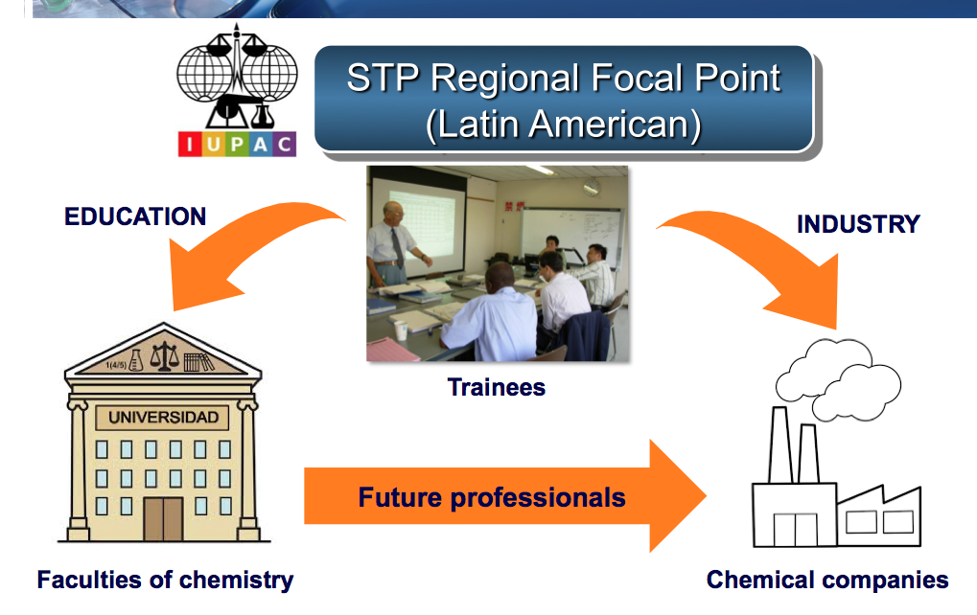
Fabian Benzo
Proposal for a Regional Centre

Slide 59

Company Associate Program
Relationships with internationally-based industrial corporations and scientific businesses allows for the exchange of information regarding current issues inﬂuencing Chemistry and Industry.
The Committee on Chemistry and Industry (COCI) has direct involvement with Company Associates.
Notes:
This shows how an image could be used on a slide. The slides will be more interesting if the images are large but they must be of good quality, else they’ll blur like this one.

Slide 60
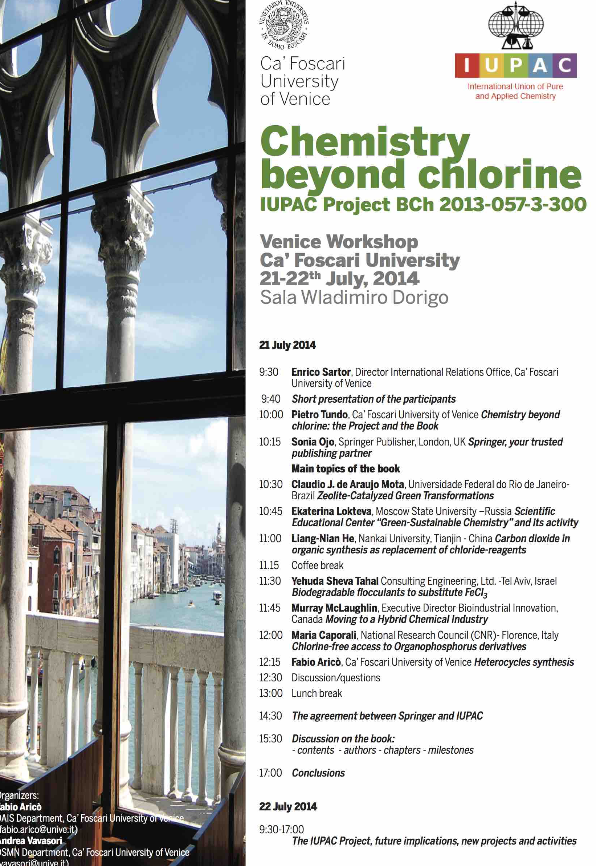
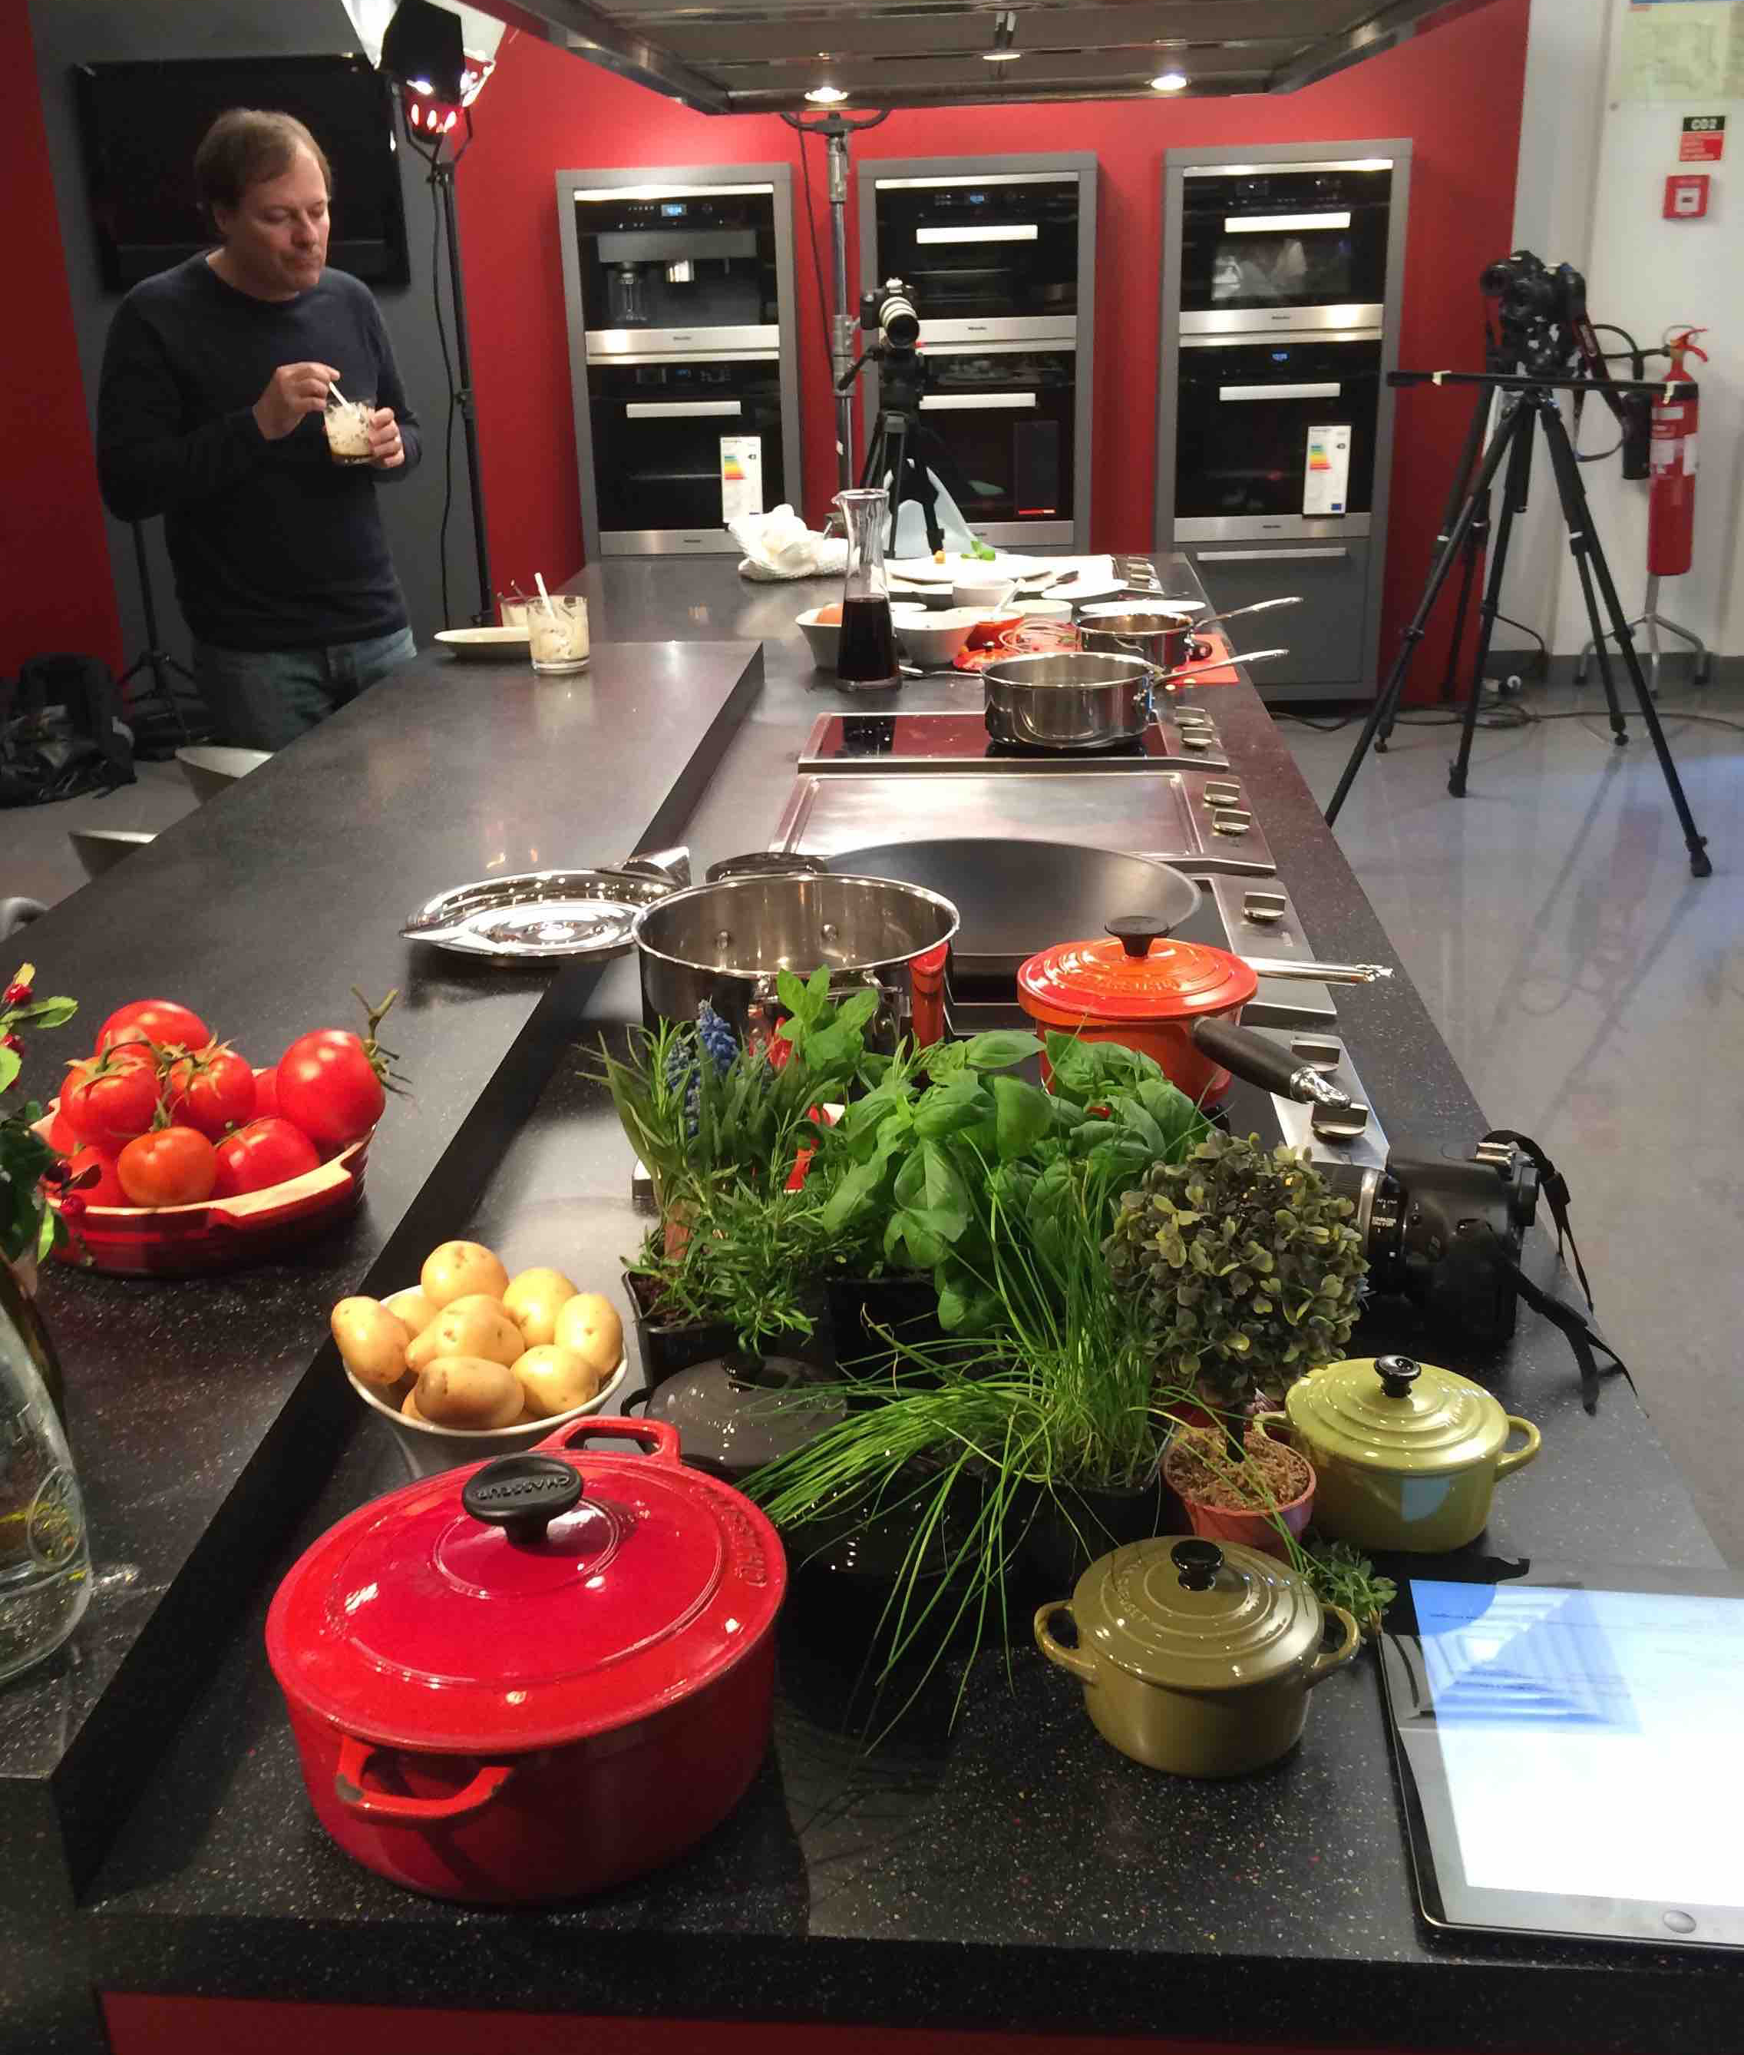
Current Projects
Chemistry beyond Chlorine (Tundo)
Healthy Life – Functional Food Ingredients
(Rauter)
Nomenclature of Cyclic Peptides
(Reaney)
Computational Chemistry – a workshop
for sub-Saharan scientists (Whitehead)
Network for Heterocyclic Chemistry within
Mediterranean/North Africa (Florio)
Nuclear Magnetic Resonance (Garson)

